Slide 1
What is IT audit?
An examination of how IT systems where implemented to ensure that they meet the organization’s business needs without compromising security, privacy, cost, and other critical business elements
WGITA – IDI Handbook on IT Audit for Supreme Audit Institutions

Slide 2
IT and basic types of audit
IT Audit is, thus, a broad term that pervades
Financial Audits - to assess the organization’s financial statements
Compliance Audits - evaluation of internal controls
Performance Audits - to assess whether the IT Systems meet the needs of the users and do not subject the entity to unnecessary risk
ISSAI 5300 paragraph 3.2

Slide 3
Objective
The Active IT Audit Manual tool is based on the IT Audit Handbook and have the essential objective of helping the auditor to plan and conduct IT audits
It provides the users with:
practical guidance
essential technical information, and
key audit questions

Slide 4
Content
Follows the general principles of auditing set out in the International Standards for Supreme Audit Institutions (ISSAI)
It provides an SAIs tailored working tool, which can be integrated with governance frameworks like the ISACA COBiT model, pronouncements of the International Standards Organization (ISO), or standards, guides and manuals from some of the SAIs

Slide 5
Structure
Centered in detailed description of different IT domains which will assist the IT auditors in identifying potential auditable areas
IT Governance
IT Operations
Development and Acquisition
Outsourcing
Information Security
Business Continuity and Disaster Recovery
Application Controls

Slide 6
Scoping
Start with planning on a risk assessment based selection
We call it scoping through IT domain cascade:
identify a specific domain or a combination of domains
select the most critical areas and issues

Slide 7
Mechanics
Extract based on the scope and objective, then
On each level:
Analyze, validate and optimize each selection
Score relative importance within the extracted list
Develop a weighted list
Scope and objective
Domains
Areas
Issues
Use the information in related Audit Matrices at Criteria, Information Required and Analysis Method levels as work base and extend as necessary
Assertions
Audit tests plan
Extract the audit steps
Check and adapt so that all key audit questions are covered
Identify the accountable and responsible roles
Establish what management claims are in place and if they are working well

Slide 8
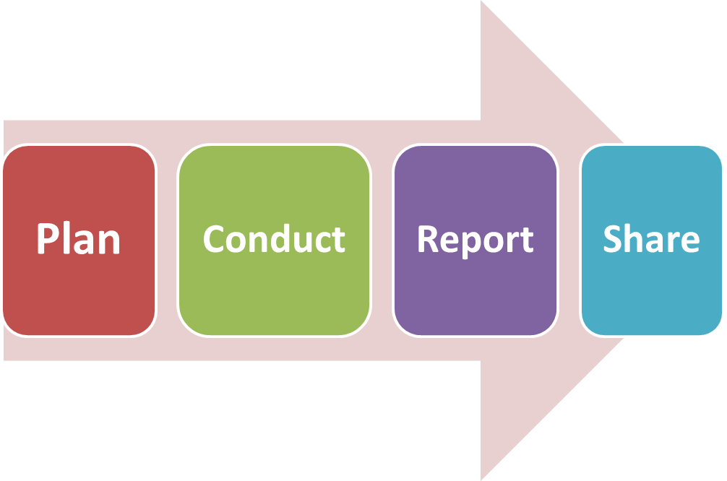
To ensure that the audit process is preserved to enable subsequent verification, monitoring and share of the audit analysis procedures (ISSAI 100 PARAGRAPH 42), the tool produces:
A template activity plan, which includes the subject, criteria and scope is produced, as well
Audit matrices to help recording the findings during the IT audit conduct
A central point to help the auditor interpreting and judging against the audit questions previously raised at the planning stage
Possibility to share with the community in the project” Control Space of e-Government” (the CUBE), an EUROSAI initiative

