Slide 1
INTOSAI WORKING GROUP ON KEY NATIONAL INDICATORS
Development of the Knowledge base on KNI
Mr. Dmitry Zaytsev
Accounts Chamber of the Russian Federation
Tsaghkadzor, April 26, 2016

Slide 2
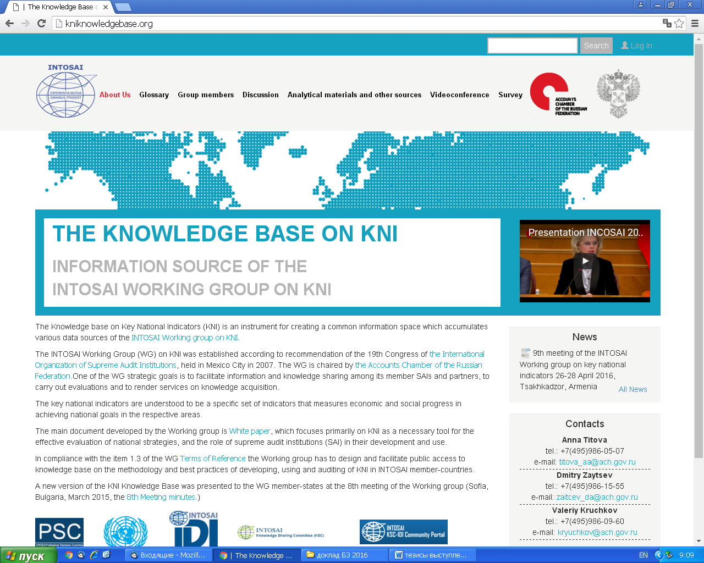
INTOSAI WORKING GROUP ON KEY NATIONAL INDICATORS

Slide 3
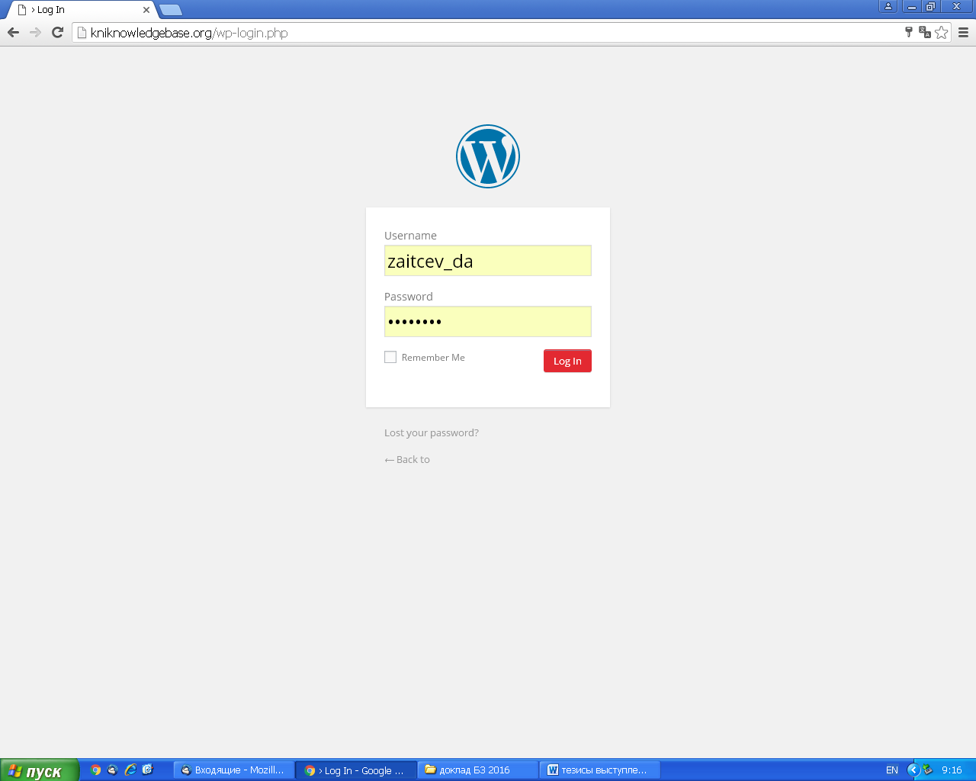
INTOSAI WORKING GROUP ON KEY NATIONAL INDICATORS

Slide 4
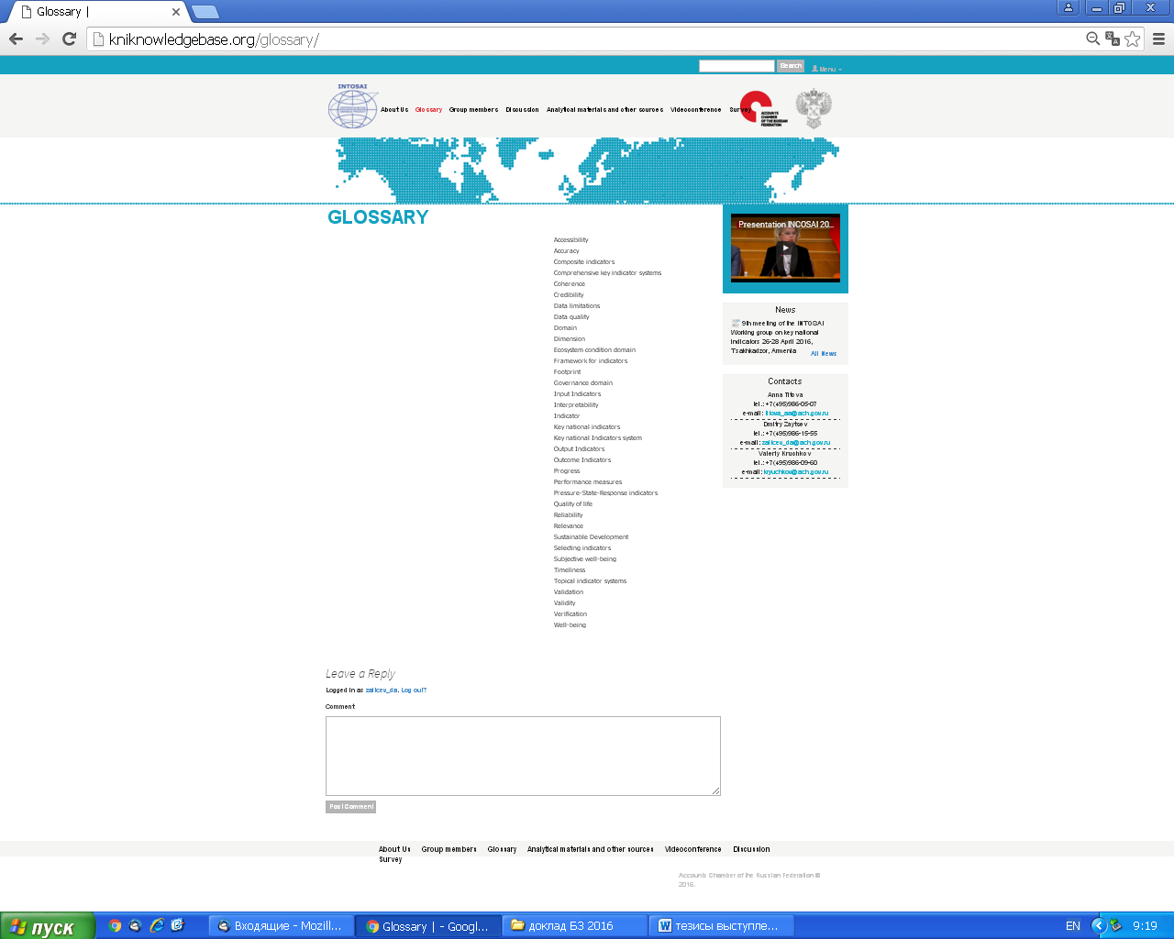
INTOSAI WORKING GROUP ON KEY NATIONAL INDICATORS
You may leave a comment

Slide 5
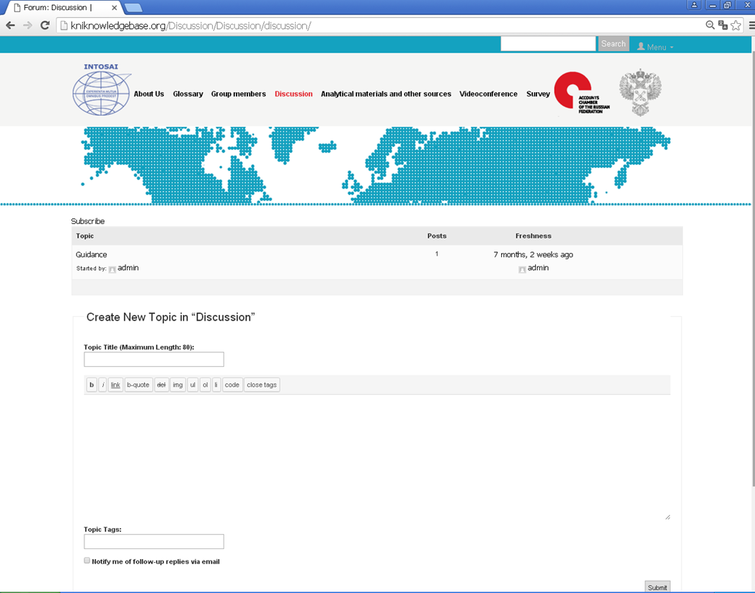
INTOSAI WORKING GROUP ON KEY NATIONAL INDICATORS

Slide 6
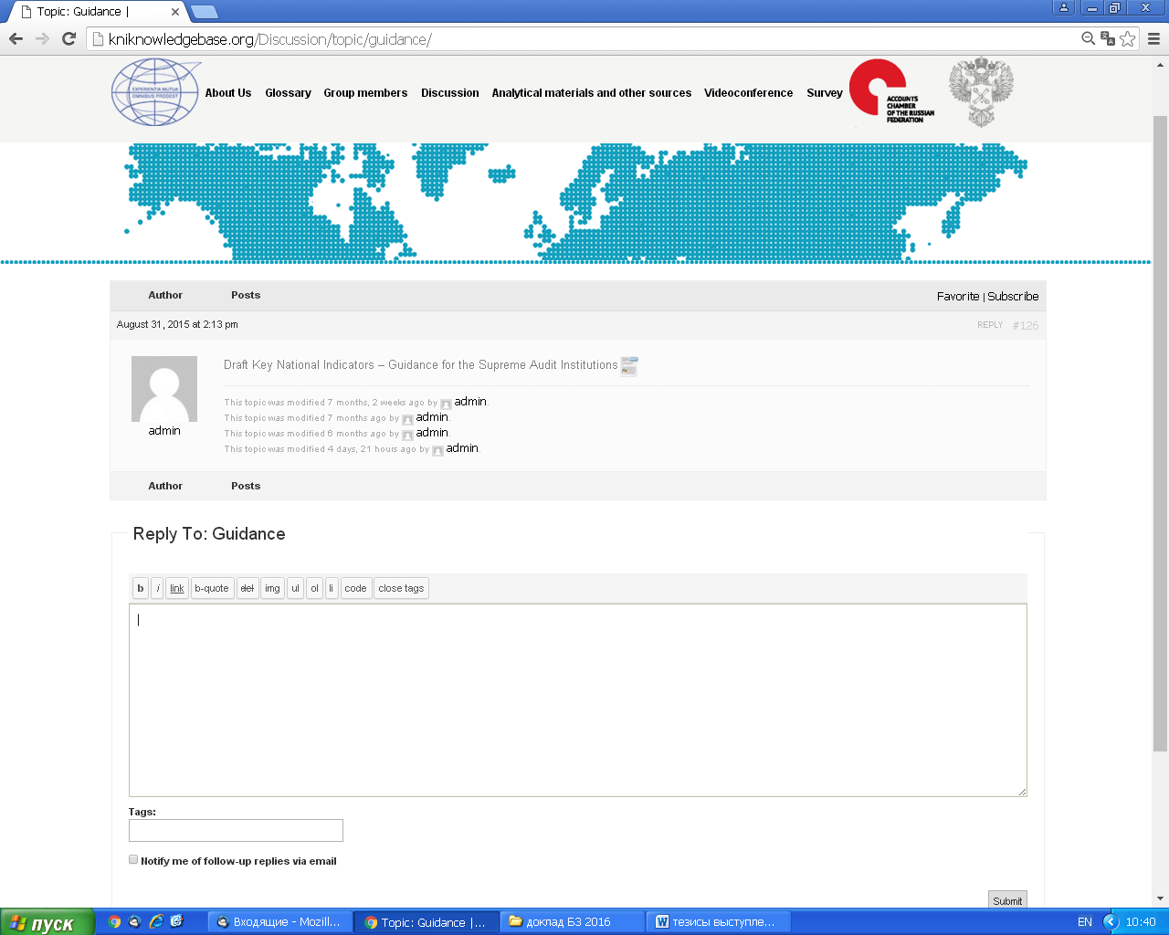
INTOSAI WORKING GROUP ON KEY NATIONAL INDICATORS

Slide 7
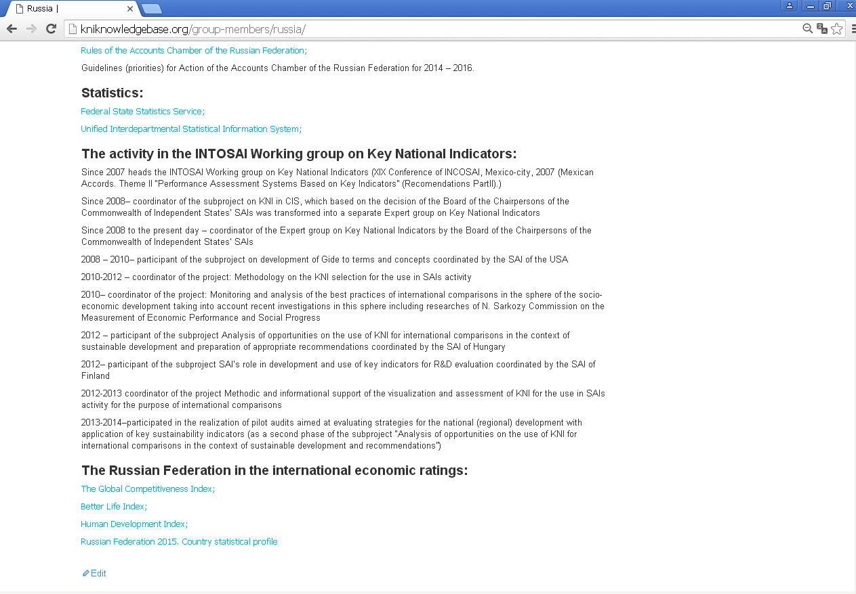
INTOSAI WORKING GROUP ON KEY NATIONAL INDICATORS

Slide 8
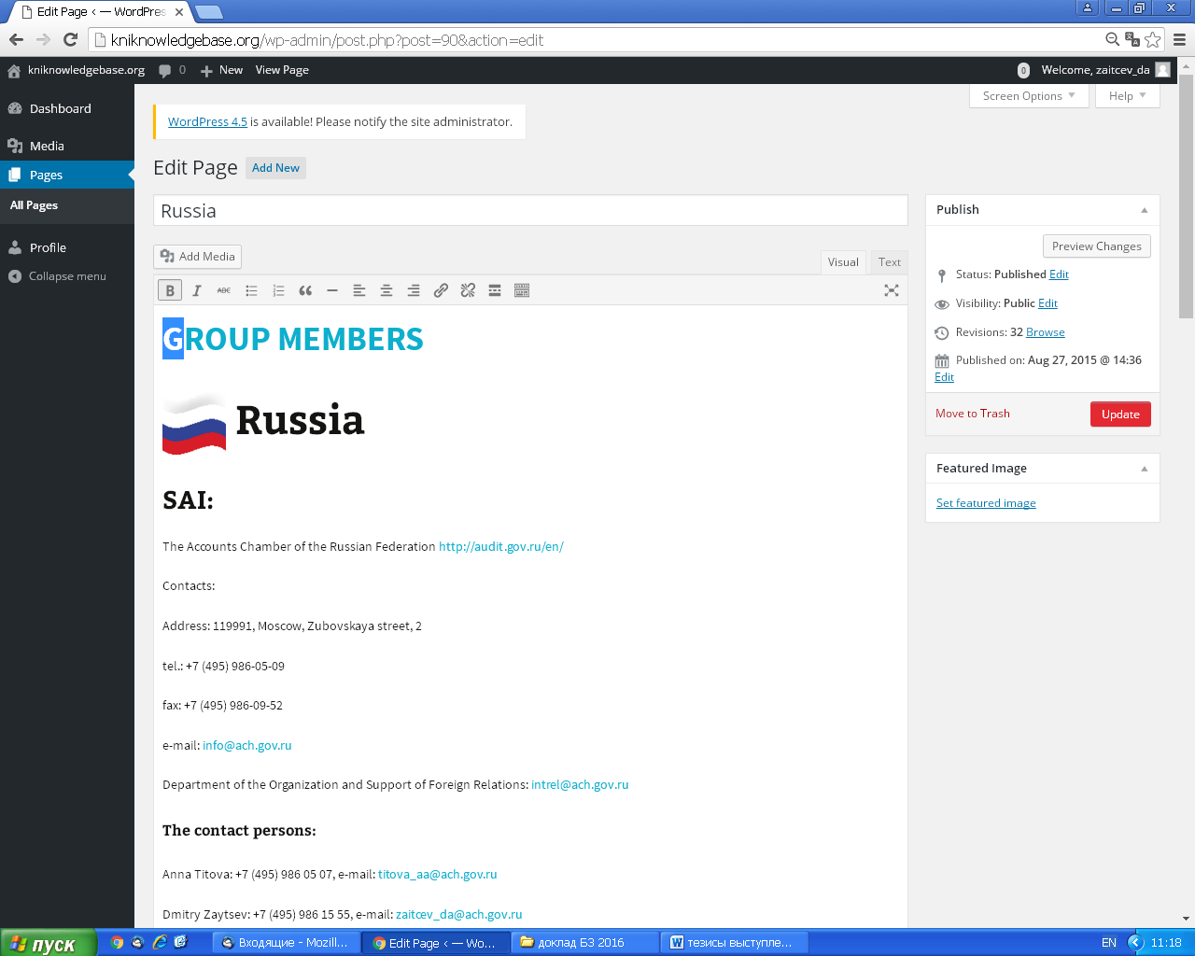
INTOSAI WORKING GROUP ON KEY NATIONAL INDICATORS

Slide 9
INTOSAI WORKING GROUP ON KEY NATIONAL INDICATORS

Slide 10
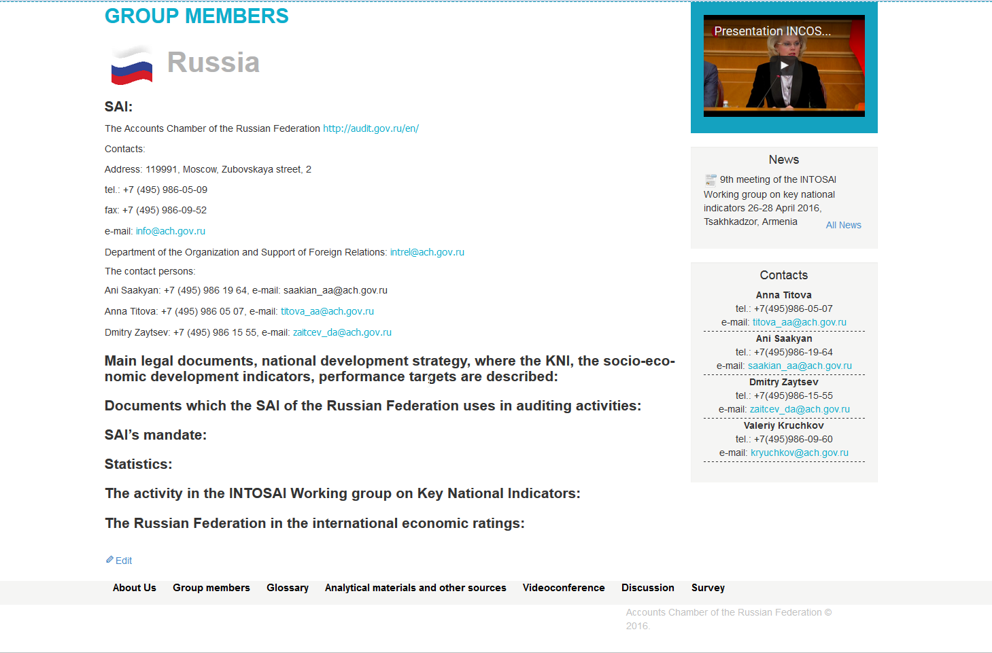
INTOSAI WORKING GROUP ON KEY NATIONAL INDICATORS

Slide 11
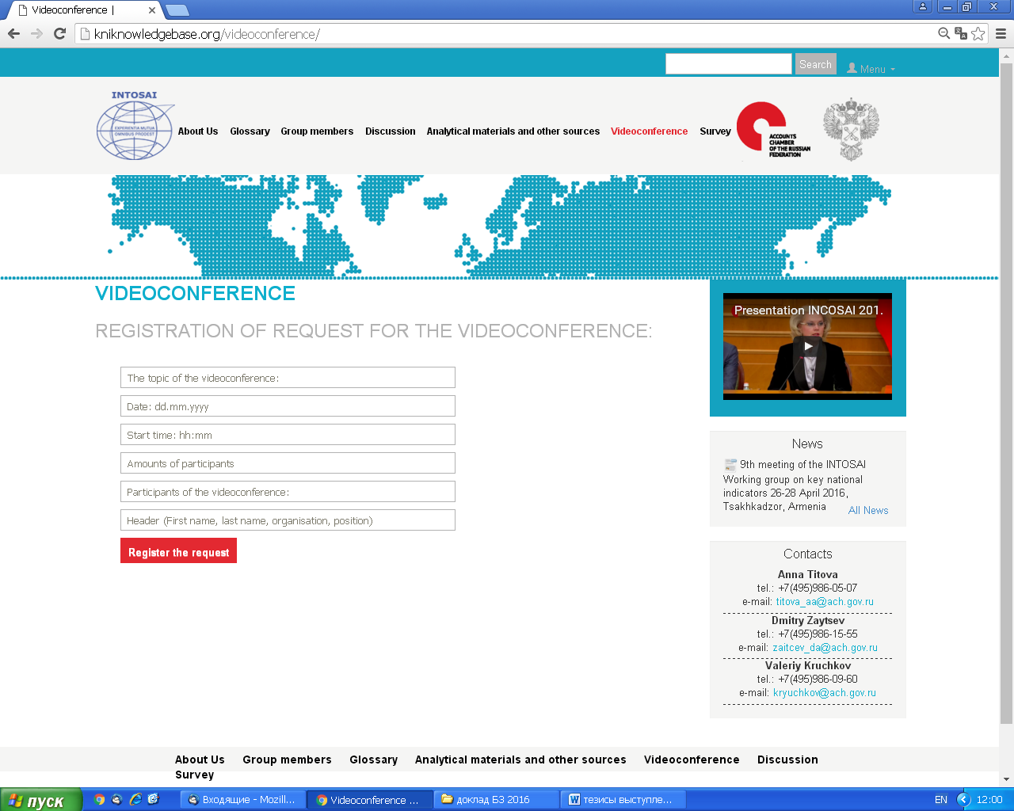
INTOSAI WORKING GROUP ON KEY NATIONAL INDICATORS

Slide 12
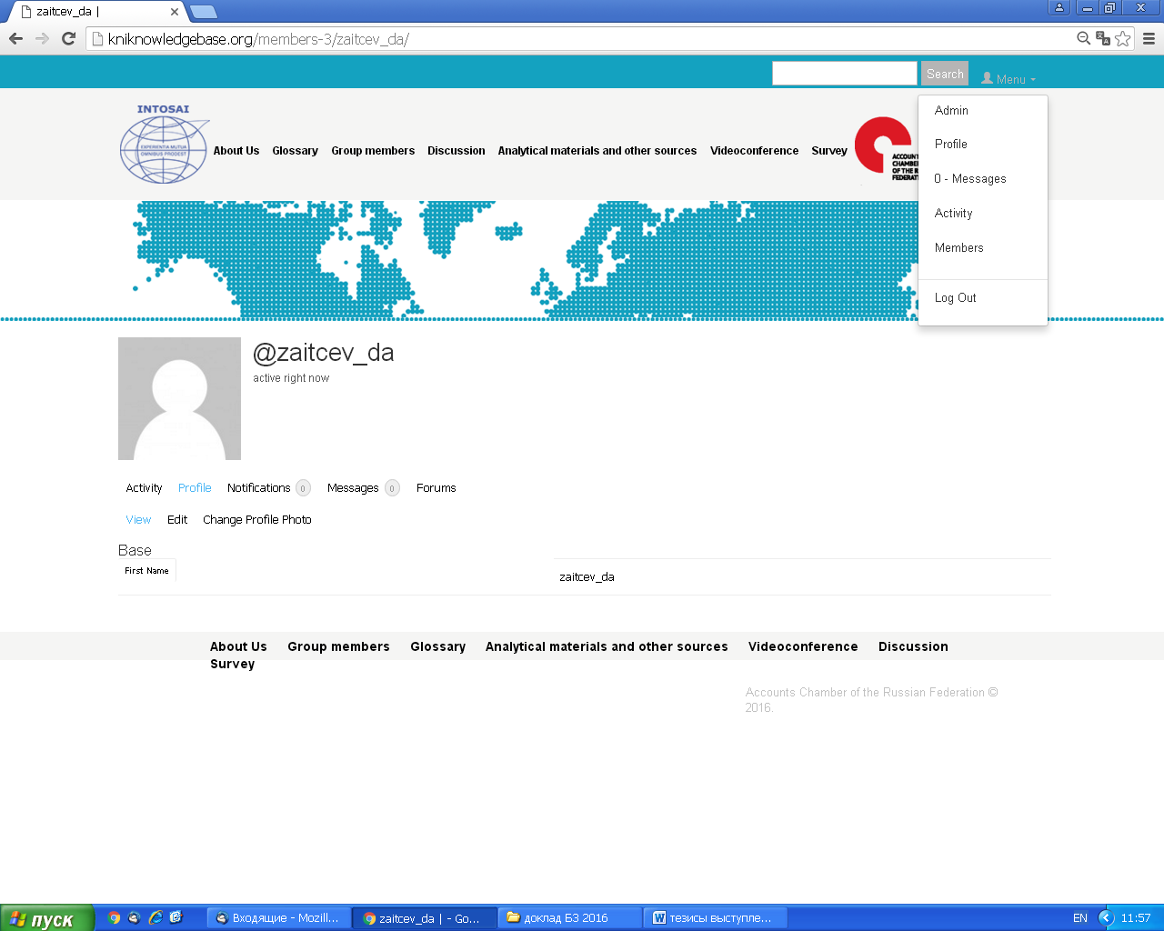
INTOSAI WORKING GROUP ON KEY NATIONAL INDICATORS

Slide 13
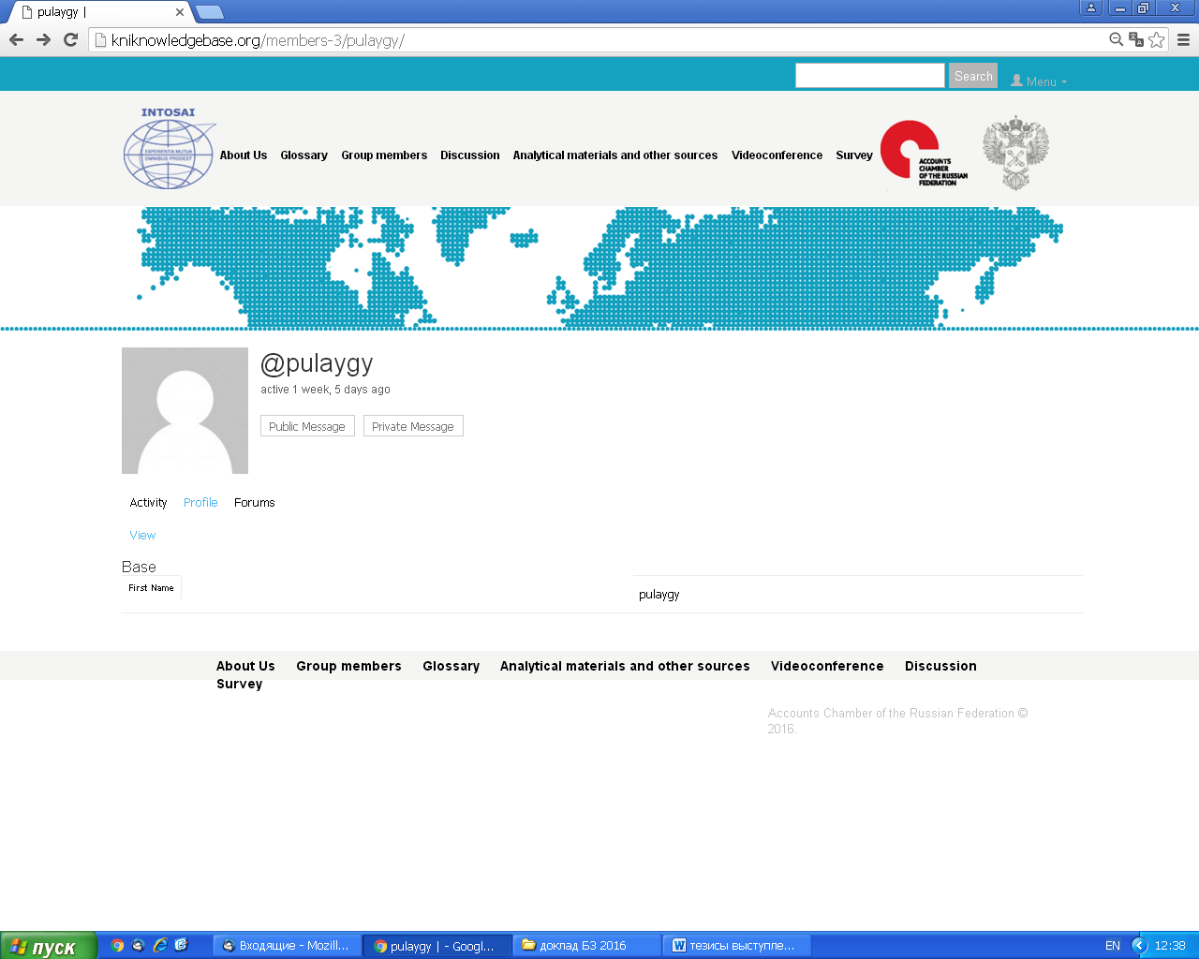
INTOSAI WORKING GROUP ON KEY NATIONAL INDICATORS

Slide 14
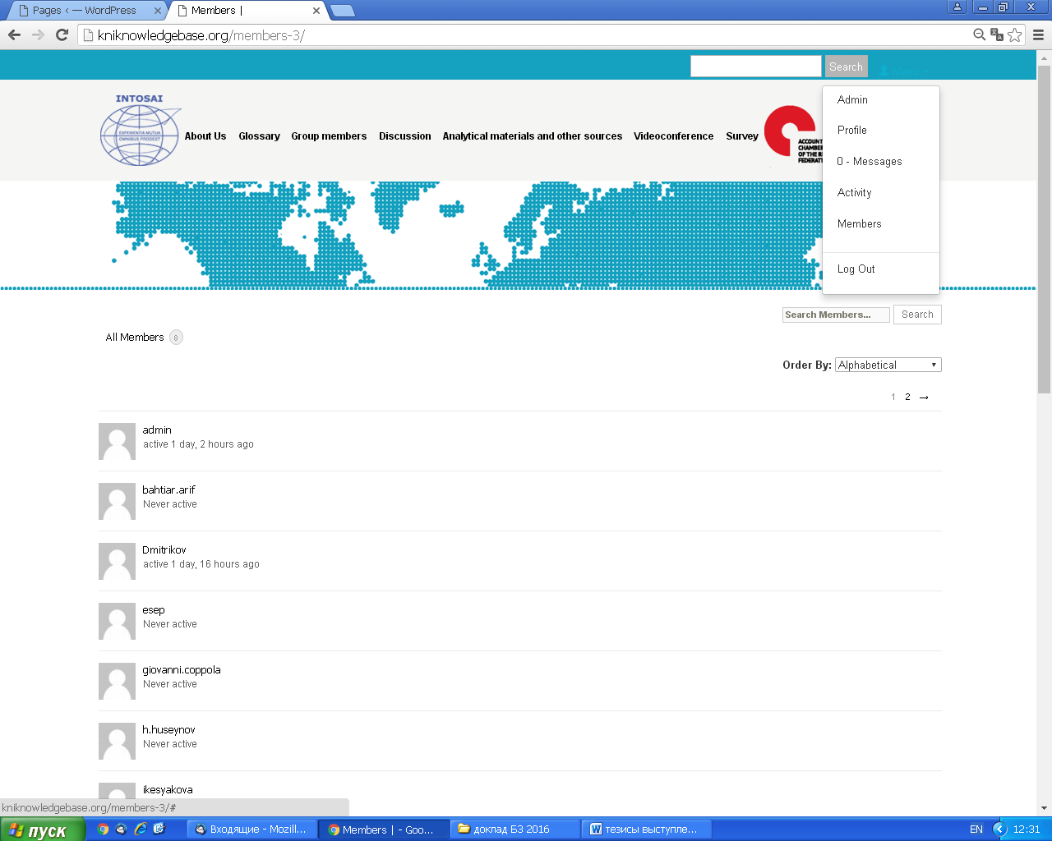
INTOSAI WORKING GROUP ON KEY NATIONAL INDICATORS

Slide 15
INTOSAI WORKING GROUP ON KEY NATIONAL INDICATORS
THANK YOU!

