Slide 1
INTOSAI WORKING GROUP ON KEY NATIONAL INDICATORS
Dmitry Zaytsev
Accounts Chamber of the Russian Federation
NEW VERSION OF THE KEY NATIONAL INDICATORS KNOWLEDGE BASE
Sofia, March 25, 2015

Slide 2
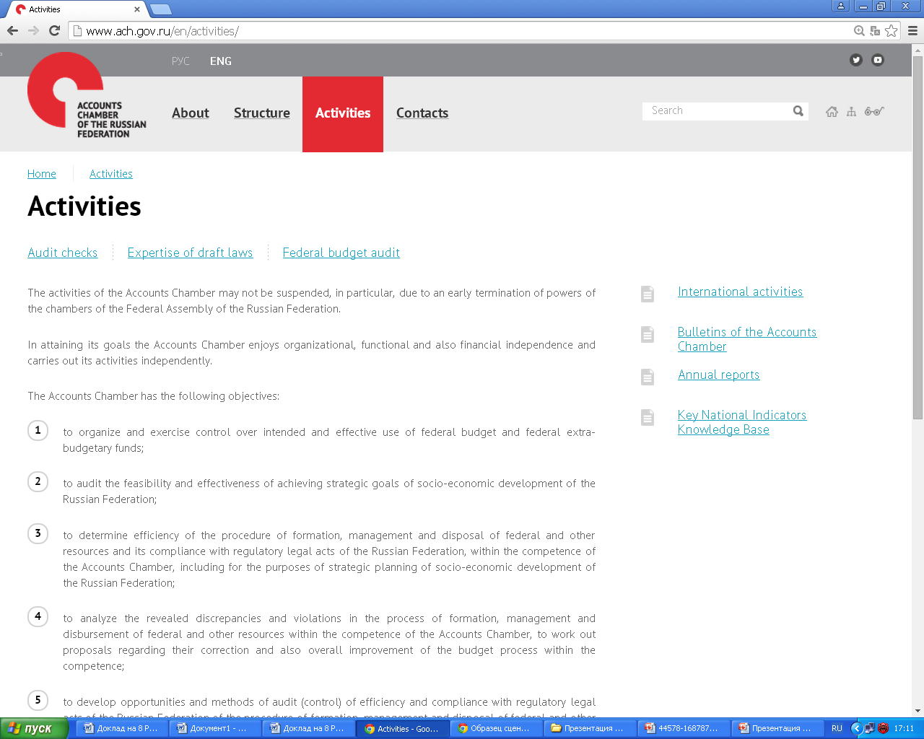

Slide 3
KNOWLEDGE BASE ON KNI
The Knowledge base on key national indicators (KNI) - the instrument for the creation of the common information space which accumulates various databases and information sources of member countries of the INTOSAI Working group on KNI and allows to carry out expeditious interaction between its users.
Terms and definitions concerning the audit with the use of KNI including the specifics of national thesauruses of member states of the Working group on its issue and the definitions accepted in the ISSAI standards
Glossary
Countries
Analytical materials
and other sources
country contribution to the Working Group on KNI,
links to the main normative documents of the country, links to the supranational organizations, links to the documents defining structure of KNI, links to the statistical services of the country.
links to statistical data on KNIs where the sources of information are national statistical services and the supranational organizations (OECD, the UN, World Bank, the IMF, Eurostat, etc.).
Results of the WG subprojects, the best practices and methods developed within the Working group on KNI and within the supranational organizations

Slide 4
GLOSSARY

Slide 5
COUNTRIES
Austria
Armenia
Bulgaria
Hungary
Indonesia
Italy
Kazakhstan
China
Latvia
Lithuania
Morocco
Mexico
Moldova
Pakistan
Poland
Russia
Slovenia
USA
Ukraine
Finland
Switzerland
South Africa

Slide 6
COUNTRY
SAI (full name of the SAI, website , address, contacts, e-mail)
SAI’s role in WG activities (WG membership, participation in WG subprojects, links to WG subprojects, official performances (reports) at WG meetings ), links to the guidelines developed within WG activities
Links to legislation and development strategies of the country that contain KNIs, economic and social development indicators or performance indicators
List of key national indicators, macroeconomic indicators
Links to the documents used in auditing activities related to KNIs
Links to the documents with specific mention of SAI's mandate related to KNIs
Links to statistical data by country
Links to information about a country inclusion in the international indexes and ratings

Slide 7
FUTURE OF THE KNOWLEDGE BASE
Videoconferences
Discussions
Surveys
On-line videoconferences. The number of the participants could reach 150 users at a time
Review, amendment and eventual agreement of WG documents by authorized users
Questionnaires and other documents. Logged-in authorized users place their answers

Slide 8
INTOSAI WORKING GROUP ON KEY NATIONAL INDICATORS
WG member-states designating contact persons responsible for communication on the KB issues and providing the Secretariat with this information | April 7, 2015
Publishing the new version of the Knowledge Base on the website of the Accounts Chamber of the Russian Federation | April 13, 2015
WG member-states providing suggestions on the new version Knowledge Base Collecting and reviewing the feedback received | April, 2015
WG member-states designated persons providing initial information (files, links, documents) to be included in the new version of the Knowledge Base | May -June, 2015
Placing the initial information in the new version of Knowledge Base and having it verified by WG member-states designated persons | July-August, 2015
WG member-states designated persons providing further information related to the new version of the Knowledge Base | Entire period

Slide 9
THE WORKING GROUP ACTIVITY REPORT

Slide 10
INTOSAI WORKING GROUP ON KEY NATIONAL INDICATORS
THANK YOU!

