Slide 1
Using KNIs to inform performance audits of crosscutting issues
J. Christopher Mihm
Managing Director, Strategic Issues
United States Government Accountability Office
6th Meeting of the INTOSAI Working Group on Key National Indicators Krakow, Poland
22-24 April, 2013

Slide 2
Update from our last meeting in Riga
My presentation last year discussed the status of national, regional, and sub-national KNI efforts in the United States in the broader context of efforts underway to enhance transparency and civic engagement under the “open government” banner.
This year, I will provide
An update on the status of U.S. efforts,
Discuss how GAO is evolving its approach to performance auditing to include a more direct focus on crosscutting issues, and
What this evolution means for us internally.

Slide 3
As was discussed last year, the US is part of the “global public management revolution” with certain overarching characteristics
The types of issues that government confronts are growing more complex and boundary-less (wicked issues).
The approaches (policy tools) that government uses to address these issues are wide ranging and increasingly indirect (hollow or third-party government).
Citizen confidence in the federal government is at historic lows and citizens are rightly demanding increased transparency and opportunities for active engagement.
All of this must take place in an environment where agencies are stressed to develop and maintain the basic capacities they need (austerity budgets, the “thinning of the hollow state”).

Slide 4
This Governance Environment is Consistent with Europe’s Plan for 2025
The European Parliament 2025: Preparing for Complexity
Four major trends
A multi-polar world
Multi-level governance
Multi-actor
Multi-tech

Slide 5
The Status of KNI Development in the United States
Coordinated national effort is dormant.
On the other hand: topical, regional, state, and local key indicator efforts continue to grow.
Likewise, international indicator efforts (e.g., World Bank, and OECD Your Better Life Index) are receiving increased attention in the United States.
The Government Performance and Result Act Modernization Act (GPRAMA) provides another opportunity to align individual programs with crosscutting national results.
Thus, KNI efforts in the U.S. will need to grow from the “bottom up” and “middle out” rather than the “top down”.

Slide 6
Governance and GAO’s High-Risk List
Areas most in need of reform or most vulnerable to fraud, waste, abuse, and mismanagement
30 areas currently on GAO’s High-Risk list
Helps focus attention of both agencies and the Congress on important issues
Began in the 1990s. Issued with each new Congress (i.e., every 2 years).

Slide 7
Most High-Risk Areas Involve Working Across Boundaries
Limiting the Federal Government’s Fiscal Exposure by Better Managing Climate Change Risks—federal agencies, state and local governments, civil society organizations, private sector, other nations
Mitigating Gaps in Weather Satellite Data—NOAA, NASA, DOD, other nations, contractors
Food Safety – 15 federal agencies involved
Protecting Critical Technologies – DOD, DHS, Commerce, State Department
Transportation Funding– DOT, state and local governments
Terrorism-Related Information Sharing – Several federal agencies, state and local governments

Slide 8
Mandate for GAO Duplication Reviews
Enacted in 2010
Identify overlap and duplication
Identify opportunities for cost saving and revenue enhancement
Reports issue in 2011, 2012, and 2013 identified 162 areas
Most recent report was issued on 9 April 2013
Also followed up on about 380 actions to address areas identified in 2011 and 2012 reports
Notes:
On next page examples include items you discussed in this talk

Slide 9
International Standards of Supreme Audit Institutions (ISSAI)
Public accountability means that those in charge of a government program or ministry are held responsible for the efficient and effective running of such. Accountability presupposes public insight into the activities of the program or ministry. Performance auditing is a way for taxpayers, financiers, legislatures, executives, ordinary citizens and the media to ‘execute control’ and to obtain insight into the running and outcome of different government activities. Performance auditing also provides answers to questions such as: Do we get value for money or is it possible to spend the money better or more wisely? A criterion of good governance is that all public services (or all government programs) are subjected to auditing.
Performance auditing is an independent examination of the efficiency and effectiveness of government undertakings, programs or organizations, with due regard to economy, and the aim of leading to improvements.

Slide 10
How GAO is Evolving Its Approach to Performance Auditing to Include a More Direct Focus on Crosscutting Issues
Reviewing the federal government’s results-orientation
Evaluating collaborative mechanisms
Assessing government’s capacity
Responding internally

Slide 11
Reviewing the Federal Government’s Results-Orientation
Do agencies have an appropriate crosscutting (also often called “whole of government” or enterprise) perspective to their intended results?
In that regard, are performance goals focused on meaningful outcomes (results) rather than outputs or activities?
Are the public policy tools that are being used to achieve results effective and mutually reinforcing?
How are performance data being used to drive decisions?
Looking across related portfolios of programs and initiatives, what opportunities exist to better achieve results?
What efforts are being undertaken to identify and address program overlap, duplication, and fragmentation?

Slide 12
Using Results Mapping ( A typical “logic model”)
inputs
outputs
outcomes
Staff
Funds
Products
(Activities)
Results
Clients served
Facilities
Services delivered
Impact on citizen well-being

Slide 13
Using Results Mapping ( A Results Map)
Program
Program
Outcomes and Results
Program
Program

Slide 14
Using “Stat” Reviews to Assess Progress Toward Crosscutting Goals
Compstat
Citistat
Statestat
Topical stats
“Federal Data Driven Reviews”

Slide 15
Practices that are Critical to Effective Stat Reviews
Agency leaders use data-driven reviews as a leadership strategy to drive performance improvement.
Key players attend reviews to facilitate problem solving.
Reviews ensure alignment between agency goals, program activities, and resources.
Agency leaders hold managers accountable for diagnosing performance problems and identifying strategies for improvement.
Agency has capacity to collect accurate, useful, and timely performance data.
Agency staff have skills to analyze and clearly communicate complex data for decision making.
Rigorous preparations enable meaningful performance discussions.
Reviews are conducted on a frequent and regularly scheduled basis.
Participants engage in rigorous and sustained follow-up on issues identified during meetings.

Slide 16
Evaluating Collaborative Mechanisms
Are agencies effectively coordinating their efforts across levels of government and with other sectors?
What can be done using web and social media technologies to improve government transparency and public reporting both as an anti-corruption device and to foster opportunities for greater public participation and civic engagement?
How do we ensure accountability for the proper use of funds in an environment where so much government effort is undertaken through third parties?

Slide 17
Collaborative Mechanisms
Presidential Assistants and Advisors
Collaboration Structures within the Executive Office of the President
National Strategies and Initiatives.
Interagency Groups
Designation of Leadership
Geographic-Based Offices/Co-location
Positions and Details
Specially Created Interagency Offices
Interagency Agreements and Memoranda of Understanding
Joint Program Efforts
Conferences and Communities of Practice
Collaboration Technologies

Slide 18
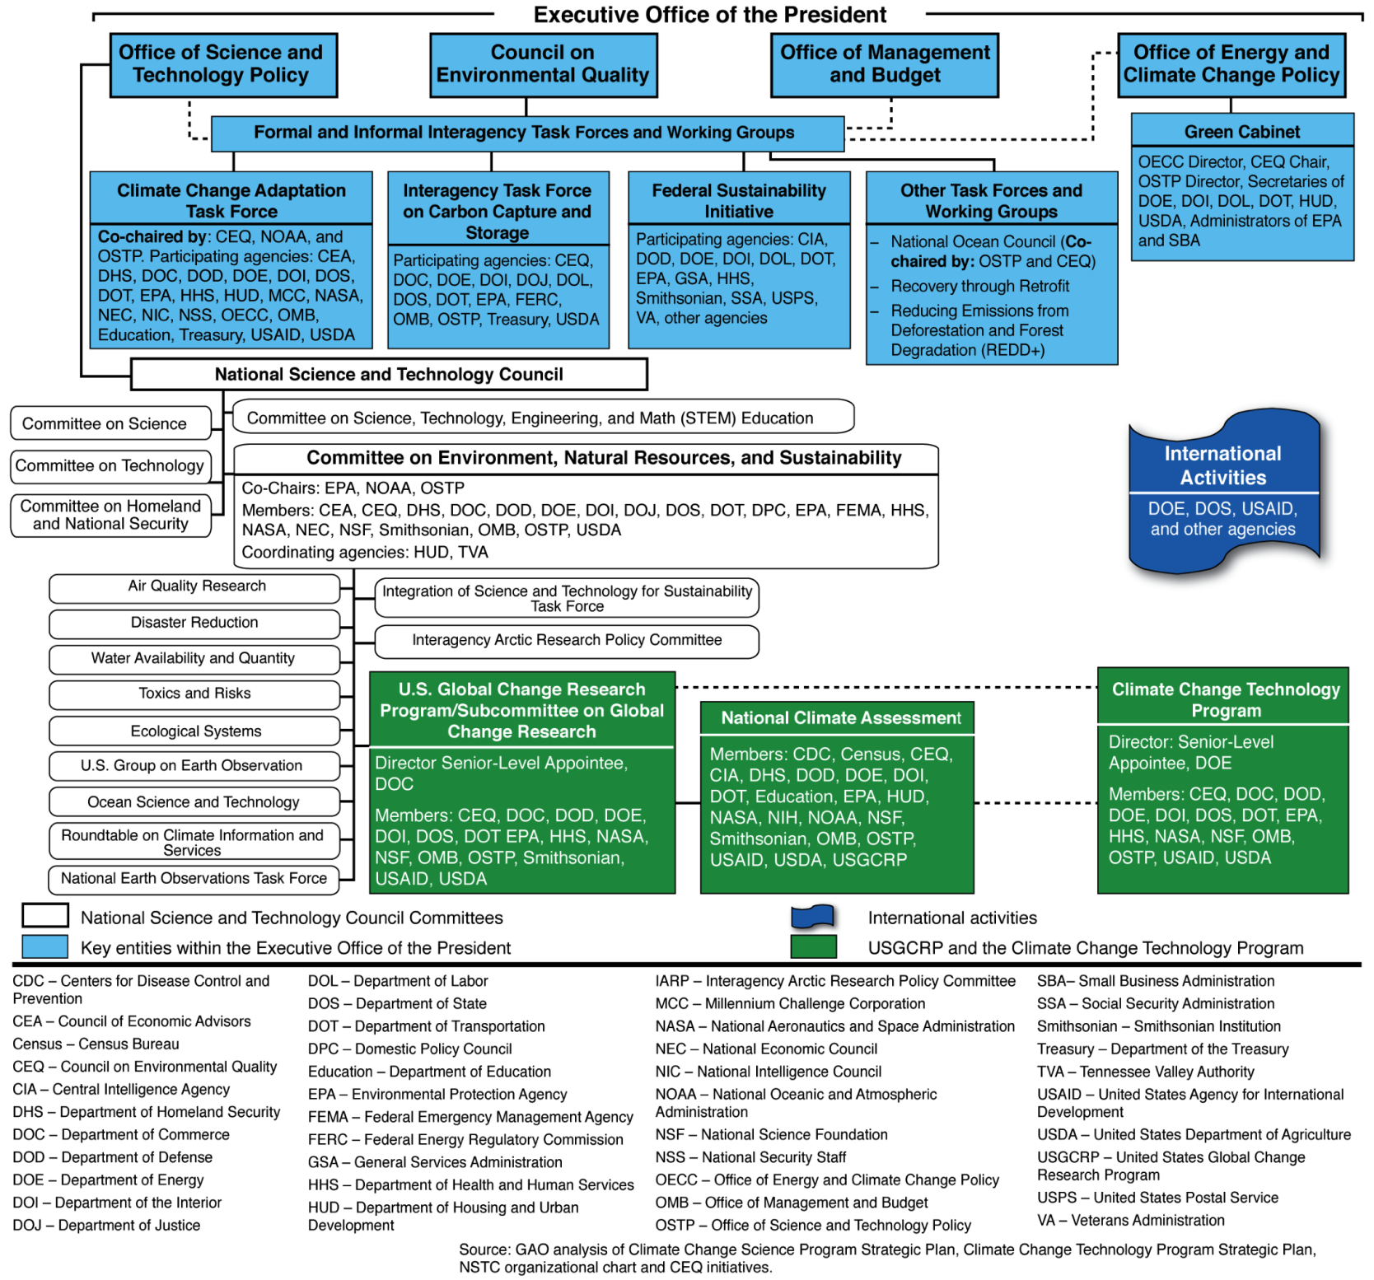
Selected Collaborative Mechanisms for Federal Climate Change Activities, as of May 2011

Slide 19
Food Safety
The January 2011—FDA Food Safety Modernization Act—strengthens a major part of the food safety system. It shifts FDA’s focus from responding to contamination to preventing it and expands FDA’s oversight authority. The law also requires interagency collaboration on food safety oversight in areas such as inspections, seafood safety, and food imports
In March 2009, the President established the Food Safety Working Group (FSWG), co-chaired by the Secretaries of Agriculture and HHS, to coordinate federal efforts and develop goals to make food safer.
It also includes officials from FDA, FSIS, CDC, the EPA, and the Departments of Homeland Security, Commerce, and State, OMB, and others.
Through the FSWG, federal agencies have taken steps designed to increase collaboration in some areas that cross regulatory jurisdictions, e.g., improving produce safety, reducing Salmonella contamination, and developing food safety performance measures.
However, the FSWG has not developed a government wide performance plan that provides a comprehensive picture of the federal government’s food safety efforts.

Slide 20
Key Issues When Implementing Collaborative Mechanisms
Outcomes and accountability
Bridging organizational cultures
Leadership
Clarity of roles and responsibilities
Participants
Resources
Written guidance and agreements

Slide 21
WWW.recovery.gov
Notes:
The stated purposes of the Recovery Act include:
preserving and creating jobs & promoting economic recovery
assisting those most impacted by the recession
investing in transportation, environmental protection, and other infrastructure to provide long-term economic benefits
stabilizing state/local government budgets, to minimize & avoid
reductions in essential services
increases in state and local taxes. [GAO web site]
GAO’s main responsibility:
bimonthly reviews of selected states’ and localities’ use of funds
Other GAO mandates include:
commenting on recipient reports on jobs created or preserved
reviewing small business lending
monitoring downturn’s long-term effect on states
Of the $787 billion, $280 billion will be administered through states and localities. [Source: GAO-09-580 Summary]

Slide 22
Assessing Government’s Capacity
How are agencies ensuring that they have the personnel skills, performance and financial information, technological capacity, and other core management capabilities that they need to respond to the challenges of governance?
How well are agencies fixing known high risk problems?
Do government agencies have robust risk management programs in place that systematically integrate the identification and management of risk into strategic and program planning?
How could agencies better streamline their internal procedures to be more efficient?
Overall, is the government an effective partner in the more complex third party governance arrangements, such a public-private partnerships (PPP or P3)?

Slide 23
Some Internal Implications of Our Evolving Approach to Performance Audits
Just as agencies need to change the way they do business in response to governance challenges, so too does GAO by:
Focusing our audit work on results and the relationships between products and services and outcomes,
Ensuring we have the internal capacity to review and assess complex governance structures, and
Engaging in collaboration among audit organizations in terms of good practice, substantive policy and program areas, and at times, on individual engagements.

Slide 24
Thank you!

Slide 25
www.gao.gov
2013 Annual Report: Actions Needed to Reduce Fragmentation, Overlap, and Duplication and Achieve Other Financial Benefits (GAO-13-279SP April 9, 2013)
Managing for Results: Data-Driven Performance Reviews Show Promise But Agencies Should Explore How to Involve Other Relevant Agencies (GAO-13-228, Feb 27, 2013)
High Risk Series: An Update (February 2013, GAO-13-283)
Managing for Results: Key Considerations for Implementing Interagency Collaborative Mechanisms (Sept. 27, 2012, GAO-12-1022)
Managing for Results: A Guide for Using the GPRA Modernization Act to Help Inform Congressional Decisionmaking (June 15, 2012, GAO-12-621SP)
Managing for Results: GAO’s Work Related to the Interim Crosscutting Priority Goals Under the GPRA Modernization Act (May 31, 2012, GAO-12-620R)
Streamlining Government: Questions to Consider When Evaluating Proposals to Consolidate Physical Infrastructure and Management Functions (May 23, 2012, GAO-12-542)
Climate Change: Improvements Needed to Clarify National Priorities and Better Align Them with Funding Decisions (May 20, 2011, GAO-11-317)
Streamlining Government: Opportunities Exist to Strengthen OMB’s Approach to Improving Efficiency (May 2010, GAO-10-394)

Slide 26
www.gao.gov (continued)
A Call for Stewardship: Enhancing the Federal Government’s Ability to Address Key Fiscal and Other 21st Century Challenges (GAO-08-93SP)
Organizational Transformation: Implementing Chief Operating Officer/Chief Management Officer Positions in Federal Agencies (GAO-08-34)
Results-Oriented Government: Practices That Can Help Enhance and Sustain Collaboration Among Federal Agencies (GAO-06-15)
Human Capital: Symposium on Designing and Managing Market-Based and More Performance-Oriented Pay Systems (GAO-05-832SP)
21st Century Challenges: Reexamining the Base of the Federal Government (GAO-05-325SP)
Human Capital: Principles, Criteria, and Processes for Governmentwide Human Capital Reform (GAO-05-69SP)

Slide 27
www.gao.gov (continued)
High-Performing Organizations: Metrics, Means, and Mechanisms for Achieving High Performance in the 21st Century Public Management Environment (GAO-04-343SP)
Results-Oriented Cultures: Creating a Clear Linkage between Individual Performance and Organizational Success (GAO-03-488)

Slide 28
GAO on the Web
Web site: http://www.gao.gov/
Congressional Relations
Katherine Siggerud, Managing Director, siggerudk@gao.gov (202) 512-4400, U.S. Government Accountability Office 441 G Street, NW, Room 7125, Washington, DC 20548
Public Affairs
Chuck Young, Managing Director, youngc1@gao.gov (202) 512-4800, U.S. Government Accountability Office 441 G Street, NW, Room 7149, Washington, DC 20548
Copyright
This is a work of the U.S. government and is not subject to copyright protection in the United States. The published product may be reproduced and distributed in its entirety without further permission from GAO. However, because this work may contain copyrighted images or other material, permission from the copyright holder may be necessary if you wish to reproduce this material separately.

