Slide 1
The development and use of KNI’s in South Africa and the role of the Auditor-General in auditing KNI’s
INTOSAI WG ON KNI - 6TH MEETING
22 - 24 APRIL 2013
Presented by Tini Laubscher

Slide 2
The AGSA mission
The Auditor-General of South Africa has a constitutional mandate and, as the Supreme Audit Institution (SAI) of South Africa, it exists to strengthen our country’s democracy by enabling oversight, accountability and governance in the public sector through auditing, thereby building public confidence.

Slide 3
Topics for discussion
Development and use of KNI’s in SA
Overview of developments in SA: 2001 to 2013
Audit mandate and strategy
Audit results to date
Role of the Auditor-General in auditing KNI’s
The way forward

Slide 4
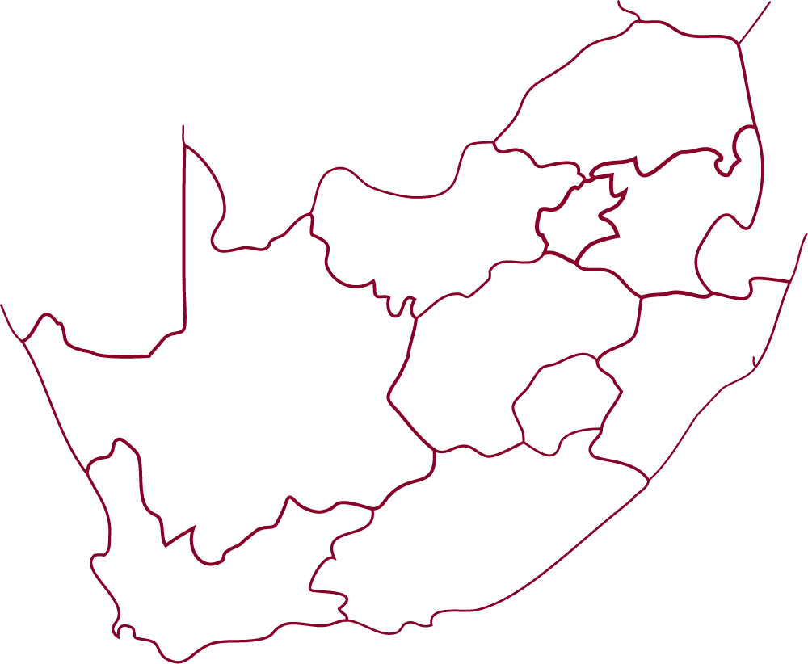
South African government context
Notes:
Presentation notes:
After the democratic elections of 1994, South Africa developed a semi federal system with three spheres of government: national, provincial and local.
Some areas of competence are unique to one sphere of government, for example land and justice are a national function. Others are shared between different spheres, for example education and health are both national and provincial and all spheres of government have responsibilities for housing and roads.
The provinces are responsible for implementation of most developmental functions, such as education, health, agriculture, social development and others; while local government is responsible for the delivery of water, electricity distribution, integrated planning, local roads and amenities.
Provinces have provincial legislatures and a strong degree of autonomy, but not as much as in a federal system ( e.g. as in Canada)
The development of KNI’s have thus to happen across these different levels, and developing a common approach across the multiple actors is a complex process.

Slide 5
Evolution of KNI’s in South Africa
2000 – 2008:
Development of KNI’s closely linked to planning and budgeting
A bottom-up approach
2009 – 2013:
Cabinet approved 12 national outcomes to guide overall development of KNI’s
A top-down approach
Notes:
Presentation notes:
Historically there have been various poles of development of KNI’s in South Africa, without a fully functional centrally driven system.
2000 – 2008:
During 2000 the Public Finance management act , PFMA (1999) was implemented with amongst others the specific requirement for accounting offices to ensure the effective, efficient economical and transparent use of resources. The PFMA requires annual reporting on the actual performance achieved against predetermined key performance indicators (KPI’s)
During the period of 2000 – 2008 the development of KNI’s and specific KPI’s for departments were closely linked to the planning and budgeting cycle of government in South Africa.
In this regard the National Treasury was the main driver of the process and the Treasury established the basic planning and monitoring and evaluation system for the South African government – BUT there was no clear overall national plan with a clear indication of national KNI’s .
In terms of this system national and provincial departments produced five year strategic plans and annual performance plans.
5. The National Treasury also introduce programme performance budgeting in national and provincial departments as part of the reform process.
Departments had to specify what funds are needed to achieve the desired outcomes and impacts by identifying the outputs and activities that needs to be undertaken to produce the outputs, and inputs required to perform the identified activities.
6. 2004
Treasury and Presidency departments started with the development of Frameworks for:
Strategic Plans,
Annual Performance Plans
Quarterly Performance Reporting (non-financial data)
Managing Programme Performance Information – containing key principles when designing key indicators and targets
2009 :
The government that came to power following the 2009 elections faced a number of pressures including widespread service delivery protests.
The Ministry of performance monitoring and evaluation was created in the Presidency in 2009 and the Presidency in early 2009 announced that an outcomes approach to the development and use of KNI’s will be established in government.
This resulted in the approval of a limited number (eventually only 12) of cross government outcomes so that efforts to promote change could be focused.

Slide 6
Development and use of KNI’s in SA
2000 - 2008
1. Development of standard budget performance programmes for concurrent functions like Education and Health
2. Treasury introduced steering committees for all national and provincial departments to agree on performance indicators for budget programmes
3. The indicator development process was challenging and still is due to lack of adequate performance information gathering systems
4. However departments agree on a core set of indicators and strive to improve the data used for reporting purposes
Notes:
Presentation notes:
Although there was no central driven system or a national plan within which to establish KNI’s (during the period 2000 to 2008), the system evolved and departments were able to identify key performance indicators to initiate appropriate and relevant service delivery in some areas. Herewith some of the benefits and challenges that were experienced during the period:
National departments focus on policy development and provincial departments on implementing policy via pre determined objectives, indicators and programmes
National Treasury introduced steering committees attended by all national and provincial departments where they all agreed on performance indicators for budget programmes (to link outputs with inputs as per budget allocations)
The indicator development process was challenging and still is due to lack of adequate performance information gathering systems
However departments agree on a core set of indicators and strive to improve the data they use for reporting purposes
Treasury facilitate workshops to allow departments to review their programme indicators annually (but keep the key set untouched as far as possible)
Other challenges included:
The individual strategic plans of departments generally included KPI at quite a low level with the result that the impact of achievement of KPI had limited results
In the absence of an overall national plan, integration between departments and performance systems were limited and in some instances not coordinated or integrated.
In other instances conceptual misalignments of KPI’s between various departments were evident.

Slide 7
2009: SA Government changed to an outcomes approach
What we wish to achieve
OUTCOMES
New
focus
What we produce or deliver
OUTPUTS
Previous
focus
ACTIVITIES
What we do
What we use to do the work
INPUTS
Notes:
Presentation notes:
The aim of the outcomes approach adopted by the SA government in January 2009 was to improve service delivery by:
Increasing strategic focus of government
Making more efficient and effective use of limited resources through introducing more systematic monitoring and evaluation:
Identifying suitable indicators and regularly measuring or monitoring them
Carrying out periodic evaluations of the impact of government’s work on society
Analysing the results of monitoring and evaluation
Using this analysis to:
inform government decisions
continuously improve government programmes
promote evidence-based policy making.
In 2010 the SA Government establish the Department of Performance Monitoring (DPME). The objective of this department is to monitor the implementation of Government priorities grouped into 12 key outcomes.
This work compliment the work done by Treasury (in the period of 2000 – 2008) as departments in many instance use the same dataset for reporting purposes on progress made against the 12 key outcomes.
Until recently, the focus has been on measuring and reporting on what is done and what is produced. The new focus extends this interest into the area of outcomes. It asks what is achieved with what is done. This does not mean that the focus is shifted away from activities and outputs so that the only interest is in outcomes. Results based management (RBM) extends the focus so that all the elements are important.

Slide 8
SA Government’s 12 National Outcomes
Quality basic education*
A long and healthy life for all South Africans*
All people in South Africa are and feel safe
Decent employment through inclusive economic growth
Skilled and capable workforce to support an inclusive growth path*
An efficient, competitive and responsive economic infrastructure network
Vibrant, equitable, sustainable rural communities contributing towards food security for all*
Sustainable human settlements and improved quality of household life*
Responsive, accountable, effective and efficient Local Government system*
Protect and enhance our environmental assets and natural resources*
Create a better South Africa, a better Africa and a better world
An efficient, effective and development oriented public service and an empowered, fair and inclusive citizenship
* Concurrent functions, outcomes coordinated by national and provincial departments and ministers
Notes:
Presentation notes:
With the announcement of the 12 National outcomes the Cabinet clearly indicated the 12 key priority areas for South Africa for the next 5 years ( 2009 2014). This formed the basis of the overall national plan for South Africa and departments had to develop appropriate indicators to allow for accurate monitoring of their services.
The initial work on the outcomes approach was very much driven by the Presidency.
Initially departments struggled to fulfill its responsibility to develop clear and appropriate indicators in support of the 12 national outcomes – this was in some instances due to lack of skills and capacity and in some instances bureaucratic unwillingness to be transparent.
To attain an outcome, all the key partners that contribute to achieving the outcome for a sector must be involved. In this regard delivery agreement s were concluded with the relevant departments . These agreements were refine and provide more detail to the outputs, targets, indicators and key activities for each outcome, and identify required inputs and clarify roles and responsibilities. It essentially spells out who will do what, by when and with what resources. A Delivery Agreement is a negotiated agreement between the key partners who will work together to deliver on an outcome.
The 12 outcomes were not initially categorized for example in social, economic and environmental categories but as part of the monitoring of the 12 outcomes several Cabinet committees (referred to as Clusters) were tasked with this responsibility. These Cabinet t committees are structured to deal with the indicators in the context of social, economic, human development, infrastructure and environmental aspects. In future the categorization of indicators will be more prominent.

Slide 9
Example: Health outcome indicators
Notes:
Presentation notes:
This slide presents some of the details from the Health delivery agreement and give an indication of the key health indicators to be achieved to ensure the achievement of the Health outcome.
For the health sector, the priority is improving the health status of the entire population and to contribute to Government’s vision of “A Long and Healthy Life for All South Africans”. To accomplish this vision government has identified four strategic outputs which the health sector must achieve. These are:
• Output 1: Increasing Life Expectancy
• Output 2: Decreasing Maternal and Child mortality
• Output 3: Combating HIV and AIDS and decreasing the burden of disease from Tuberculosis
• Output 4: Strengthening Health System Effectiveness
Linked to these outputs are indicators and targets – refer to details on slide.
These indicators were established in conjunction with the Presidency (DPME), all departments of health in SA (National and provincial), health sector experts and considering international trends

Slide 10
Development and use of KNI’s in SA – way forward
National development plan (until 2030)
Medium strategic framework (2019/2024/2029)
Detail (key) indicators and plans
Notes:
Presentation notes:
National development plan:
In May 2010 the President appointed the National Planning Commission to draft a vision and national development plan for South Africa . The final plan was adopted in December 2012 by the ruling party in South Africa.
The National development plan is a broad strategic framework. It sets out a coherent and holistic approach to confronting poverty and inequality. The plan presents a long-term strategy to increase employment and broaden opportunities through education, vocational training and work experience, public employment programmes, health, nutrition, public transport and access to information.
The plan will provide a common focus for action across all sectors and sections of the South African society.
With the adoption of the national development plan , planning in South Africa can now happen within the context of a long-term overall national strategic vision and plan.
The plan was drafted considering the context of a changing global economy, globalization, climate change, technological changes and other relevant factors.
Medium strategic framework (MTSF) and key indicators:
This framework will contain the critical indicators and targets to be achieved for 2014 - 2019 and for every subsequent 5 year cycle thereafter. The MTSF in each cycle should clearly contextualize the overall national priorities as per the national development plan to ensure that the long term vision and plan is achieved by 2030.
It is foreseen that some of the 12 national outcomes will have to be extended or changed to ensure alignment with the overall vision as per the National development plan.
The formulation of key national indicators will still happen within the broader outcomes approach framework – thus the national development plan objectives will have to be translated into measurable indicators and targets at outcome, output and activity level.

Slide 11
Role of the Auditor-General in auditing KNI’s

Slide 12
Audits performed by AGSA
Annual mandatory audits
Audit of financial statements
Discretionary audits
Performance audits
Audit of performance reports (Reports on key indicators)
Audit of compliance with laws and regulations
Notes:
Audits by the AGSA is conducted in terms of the Public Audit Act of 2004

Slide 13
Legislative requirement – audit of performance reports
Sections 20(2)(c) and 28(1)(c) of the Public Audit Act (PAA)
An audit report must reflect an opinion or conclusion relating to the performance of the auditee against predetermined objectives
Applicable to all spheres of government
Notes:
AGSA is constitutional institution, established in terms of the Chapter 9 of the Constitution to support constitutional democracy
Section 188 of the constitution gives rise to the functions of the AG in terms of auditing.
In relation to AOPO, sections 20 and 28 of the PAA gives the AG the mandate tp express an audit conclusion
Section 20 applies to auditors of the AG’s office while section 28 applies to auditors in private practice who audit government institutions.
The audit of predetermined objectives is applicable to all national and provincial departments and public entities and local government.
al

Slide 14
Performance management and reporting framework
The following represents the performance management and reporting framework against which the performance information should be managed and reported. Auditors use principles and requirements from framework as a basis for the audit.
All relevant laws and regulations
Framework for the managing of programme performance information
Framework for strategic and annual performance plans
(issued by the National Treasury)
Circulars and guidance issued by the National Treasury regarding the planning, management, monitoring and reporting of performance information
Refer to annual AG Directive

Slide 15
Audit criteria
Main criteria
Sub-criteria
Existence
Compliance with regulatory requirements
Timeliness
Presentation
Measurability
Usefulness
Relevance
Consistency
Validity
Reliability
Accuracy
Completeness
Notes:
Compliance with regulatory requirements:
Existence : Objectives, indicators and targets must be predetermined and performance information must be reported against them
Timeliness : Performance information must be reported within two months after year end
Usefulness
Presentation: Performance against predetermined objectives is reported using the relevant principles from the National Treasury guidelines.
Measurability : Indicators are well defined and verifiable, and targets are specific, measurable and time bound, as required by the National Treasury Framework for managing programme performance information.
Relevance : The indicators/measures relate logically and directly to an aspect of the institution's mandate and the realisation of strategic goals and objectives, as required by the National Treasury Framework for managing programme performance information.
Consistency : Objectives, indicators and targets are consistent between planning and reporting documents as required by the National Treasury regulations.
Reliability:
Validity : Reported performance has occurred and relates to the institution.
Accuracy : : Amounts, numbers and other data relating to reported performance have been recorded and reported correctly.
Completeness : All actual performance that should have been recorded has been included in the reported performance information.

Slide 16
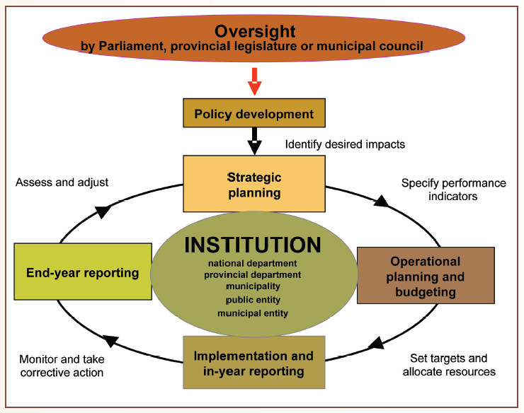
Auditing the planning, budgeting and reporting cycle

Slide 17
PFMA 2011-12 Findings on predetermined objectives
Auditees with no PDO findings
Auditees with PDO findings
Notes:
Slight overall improvement in number of auditees with findings on PDO (71 improved but 50 regressed). Good results and improvement more pronounced for public entities
Most findings relate to Usefulness of the performance reporting – an area where correction can not be made by the auditee as it can for the reliability criteria.

Slide 18
For further reference
12 National outcomes and national development plan:
http://www.thepresidency-dpme.gov.za/dpmewebsite/Page.aspx?Id=171
http://www.poa.gov.za/Pages/HomePage.aspx
Performance management frameworks:
http://www.treasury.gov.za/publications/guidelines/default.aspx
Auditor-General audit reports:
http://www.agsa.co.za/audit-reports/National.aspx
http://www.agsa.co.za/audit-reports/Provincial.aspx

Slide 19
THANK YOU

