Slide 1
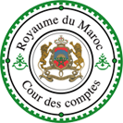
6th Meeting of the INTOSAI Working Group on Key National Indicators 23-24 April, 2013, Krakow
Presentation of the Moroccan Court of Accounts
New Member of the WGKNI

Slide 2
Overview
Morocco in the world
The Moroccan Supreme Audit Institution: the Court of Accounts
KNI in Morocco
KNI as a tool of audit in Morocco
Expectations

Slide 3
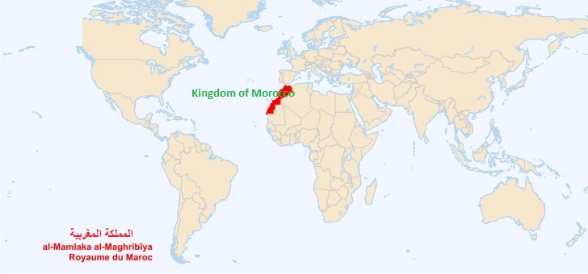
Morocco in the world
The Kingdom of Morocco is the most westerly of the North African countries. It has Atlantic and Mediterranean coastlines.
Morocco is a constitutional, democratic, parliamentary and social Monarchy.
Arabic is the official language of the State. Likewise, Tamazight [Berber/amazighe] constitutes an official language of the State, being common patrimony of all Moroccans without exception. French is widely spoken.
The major resources of the Moroccan economy are agriculture, phosphates and tourism . Sales of fish and seafood are important as well. Industry and mining contribute about one-third of the annual GDP.
Morocco is an ethnically diverse country with a rich culture and civilization . Through Moroccan history , it has hosted many people coming from East (Phoenicians, Carthaginians, Jews and Arabs), South (Sub-Saharan Africans) and North (Romans, Vandals, Andalusians, Moors and Jews). All those civilizations have had an impact on the social structure of Morocco.
Islam is the religion of the State, which guarantees to all the free exercise of beliefs.
Notes:
Morocco has a population of over 32 million and an area of 710,850 km^{2.}
The political capital is Rabat, although the largest city is Casablanca; other major cities include Marrakesh, Tangier, Tetouan, Salé, Fes, Agadir, Meknes and Oujda.

Slide 4
The Moroccan Court of Accounts
The Court of Accounts [Cour des Comptes المجلس الأعلى للحسابات] is the superior institution of control of the public finances of the Kingdom. Its independence is guaranteed by the Constitution.
The Court of Accounts has for mission the protection of the principles and values of good governance, of transparency and of the rendering of the accounts of the State and of the public organs .
The Court of Accounts is charged to assure the superior control of the execution of the laws of finance. It assures the regularity of the operations of receipts and expenditures of the organs submitted to its control by virtue of the law and appraises their management. It sanctions, the case arising, the omissions of the rules which govern said operations.
The Court of Accounts controls and assures the submission of the declarations of patrimony, audits the accounts of the political parties and verifies the regularity of the expenditures of the electoral operations.
The Court of Accounts assists the Parliament in the domains of control of the public finances. It responds to the questions and consultations in relation to the functions of legislation, of control and of evaluation, exercised by the Parliament and relative to the public finances.
The Court of Accounts gives its assistance to the judicial instances.

Slide 5
The Court of Accounts
The Court of Accounts assists the government in the domains relevant to is competence by virtue of the law.
It publishes all of its works including the specific reports and the jurisdictional decisions.
It submits to the King an annual report on all of its activities, which it transmits equally to the Head of Government and to the Presidents of the two Chambers of the Parliament. This report is published in the Bulletin officiel of the Kingdom.
A commentary on the activities of the Court is presented by its First President before the Parliament. It is followed by a debate.
The regional Courts of accounts (9 courts) are charged to assure the control of the accounts and of the management of the regions and of the other territorial collectivities and of their groups . They sanction, the case arising, the omissions to the rules which govern the public financial operations.
The composition, the organization, the attributions and the modalities of the functioning of the Court of Accounts and of the regional courts of accounts are established by the law (financial jurisdictions code) .
The members of the financial jurisdictions have the statue of magistrates.

Slide 6
Main providers of KNI in Morocco
High commission on planning (Haut Commissariat au Plan) : www.hcp.ma
Ministry of finance : www.finances.gov.ma
Central Bank of Morocco (Bank al Maghrib) :
www.bkam.ma
Ministry of Interior (Territorial Units)
Sectorial ministries
Other institutions

Slide 7
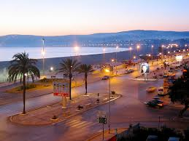
Key national indicators
Macroeconomic indicators
National accounts
Balance of the payments
Exportations
Importations
Money, inflation and stock exchange.
Exchange rate
Public finance indicators
Public expenditures
Public resources
Debt
Sectorial indicators
Agriculture
fisheries
Mining
Energy
Water
Industry
Real estate
Transports and logistics
Tourism
Telecommunications
insurance

Slide 8
Key national indicators
Social indicators
Population
Employment
Healthcare
Prices and cost of living
Basic equipments
Education and professional training

Slide 9
Main available economic and social data and indicators
Data about activity, employment and unemployment (quarterly, annual)
Regional statistical yearbooks (annual)
Exploratory and prospective Economic budgets
National accounts
Demographic studies
Demographics: indicators for monitoring and evaluation of population policy in Morocco
Human development
Surveys on industry, mining, energy and collective equipments (realizations and forecasts)
Consumer Price index
Industrial production index
Producer price index
Social indicators
Investment of public administration sector
Prospective studies
Regional monographies
Studies about poverty and welfare state
Economic census
Data on informal sector
Production and consumption structure of enterprises

Slide 10
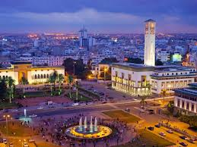
The National Instance of Probity, of the Prevention and of the Struggle Against Corruption [Instance nationale de probité, de la prévention et de la lutte contre la corruption]
Global index of integrity
Global index of competitivity
Corruption index / Transparency International
Transformation Index of Bertelsmann
Index of perception of corruption
Business environment and corporate performance index
Economic liberty index
Governance indicators in the world

Slide 11
KNI and Court of accounts
The Moroccan Court of Accounts do not compose its own set of indicators to evaluate the audited activities of the Government and public institutions
When evaluating the execution of the state budget, the Court of Accounts examines the macroeconomic indicators and – on that basis – evaluates the Government’s activity .
KNI are occasionally used by the Court’s magistrates when examining the performance of some audited activities.

Slide 12
Expectations
Enhanced participation of SAIs in unifying conception methodologies of KNI
Set up a practical manual for public auditors on the use of KNI
Develop the white paper about KNI as a guideline for SAIs in the development and use of the KNI
Regular evaluations of the action of the WGKNI/INTOSAI

Slide 13
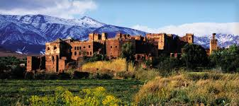
Thank you for your attention
Takidine AHANDOUR
President of Section
Chamber IV
Court of Accounts of Morocco
Secteur 10, Zenkat Ettoute, Hay Ryad, Rabat, MOROCCO
Takidine.ahandour@courdescomptes.ma
tahandour@gmail.com
Tel. +212537576731
Cell. +212641991364

