Slide 1
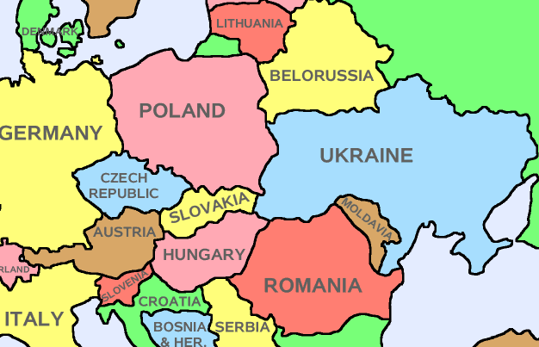
The activity of Court of Accounts of the Republic of Moldova in the context of the reforms and priorities of the country's strategic development
The 6th meeting of the INTOSAI Working Group on Key National Indicators
Счетная палата
Республики Молдова
23-24 April 2013, Krakow

Slide 2
What does the presentation include?
About Moldova
About the Court of Accounts
Reforming results
About KNI in the Republic of Moldova
The use of KNI in the audit activity

Slide 3
Where is Moldova?

Slide 4
About Moldova
Capital – Chisinau (population - 785,100 citizens)
Parliamentary republic
Independence recognized
- 25th December1991
Area – 33,800 kм2
Population– 3,9 millions citizens
Member of: UN, Latin Union, Council of Europe, OSCE, GUAM, CIS.

Slide 5
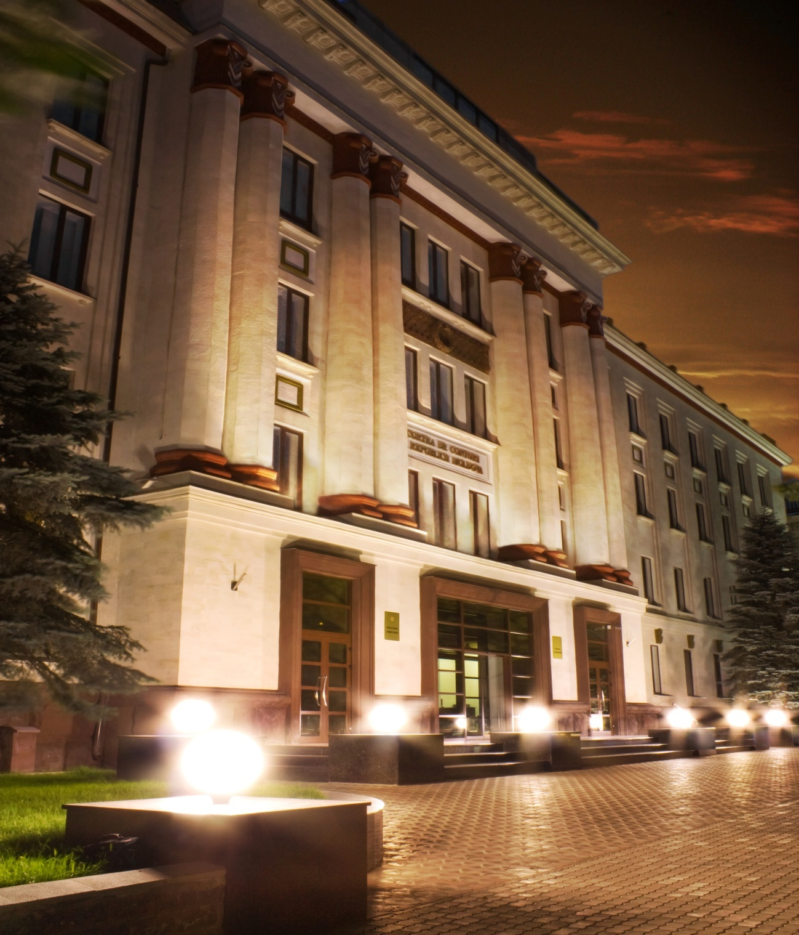

Slide 6
When was the Court of Accounts established
The Court of Accounts was established by the Department of State Control, which has existed since 1991;
The Court of Accounts was for the first time featured in the Concept of state control and which was approved in July 1994;
Art. 133 of the Constitution of the Republic of Moldova, adopted on 29.07.1994, provides that the Court of Accounts is the body of the financial control of the country;
On December 8th 1994,The Parliament passed a law on Court of Accounts, since then, this has been the official day of the Court of Accounts.

Slide 7
Why did the Court of Accounts start the reformation ?
Adherence to sectoral standards and best practices
Reform of the public financial management, and the introduction of the state internal control
Paragraph 42 of the Republic of Moldova – European Union Action Plan (22.02.2005)
Government programs and country development strategies

Slide 8
Development priority directions of the Court of Accounts for the period 2006-2010
SDP provided four directions for reforming the Court of Accounts:
Institutional Strengthening
Profession Building
Developing People
Generating greater impact from our work.
Transition from external control to external audit

Slide 9
Outcomes
05.12.2008 the new Law on Court of Accounts was adopted;
Standards and manuals for auditing: regularity, performance, IT and quality control; are developed, approved and implemented in the audit activity;
Designed and approved the 24 internal regulatory acts, including the Strategy of: staff training, communication, human resources management.

Slide 10
Mission, Vision, Values
Mission
Vision
Values
To carry out independent, credible, transparent and professional audits of financial resources and public assets management, which promote high standards of financial management for the benefit of the citizens of Moldova
Better audit to promote greater accountability and better management of public funds.
Independence - Transparency - Integrity - Competence - Tenacity - Dynamism - Co-operation - Learning from others - Effectiveness
Notes:
,

Slide 11
Strategic development objectives
Institutional Maturity
Enhanced Professionalism
Doing more for less
Stronger internal and external accountability and transparency

Slide 12
The main objectives and principles of the Court of Accounts
a) to assess the regularity, legality, conformity, economy, efficiency, and effectiveness of the management of public financial resources and assets;
b) to promote the internationally recognized standards on transparency and accountability in the area of public financial management;
c) to ensure transparency by informing the accountable public authorities and the public about its strategic and annual plans, findings and recommendations;

Slide 13
The principles of conducting the audit
Legality
Independence
Objectivity
Transparency

Slide 14
Status of the Court of Accounts
The Court of Accounts is the only state public authority that controls the formation, management and use of public financial resources and management of public property by carrying out external audit in the public sector as a Supreme Audit Institution.
Court of Accounts has organizational, functional, operational and financial independence and is legally protected against interference of law enforcement or control bodies.

Slide 15
Types of Audit
Compulsory audits :
The Court of Accounts shall carry out annually, on a compulsory basis, the audit of the Government reports on the execution of the following during the expired budgetary year of:
the state budget;
the state social insurance budget;
the compulsory medical insurance funds.
Types of Audit :
Regularity audit
Performance audit
Other types of audit (IT, etc.).
The Court of Accounts may audit the use of resources, allocated by the European Union, development partners and other donors, whose resources were included in the state budget or budgets of administrative-territorial units.

Slide 16
The Areas Subject to Audit
the use by public institutions, of grants and funds allotted by foreign donors for the implementation of programmes in which the Republic Moldova participates;
the use of budget allocations for investments, subsidies, and other forms of government financial assistance;
the accounting records and financial reporting;
the formation and use of state budget funds, state social insurance budget, budgets of the territorial-administrative units, budgets of the compulsory health insurance funds;
the activity of other control/public financial audit bodies as well as of the internal control systems;
administration and management of public assets;
the process of privatization of state assets and of ensuring the post-privatization activity;
administration and management of natural resources;
other types of activity referred to by organic laws to the competence of the Court of Accounts.

Slide 17
Entities Subject to Auditing
the central and local public administration;
Court of Accounts
institutions and organizations financed from the national public budget;
economic agencies, the authorized capital of which belongs entirely to the state or the state's share in the authorized capital is more than 50 %;

Slide 18
Presentation of the audit activity results
Statement: The audit reports are considered at the public meetings of the Plenum. The reports and the resolutions of the Court of Accounts are published in the Official gazette of the Republic of Moldova during 15 days after its approval/adoption.
Dissemination: The audit reports are submitted to the audited entities, higher authorities, including the President of the Republic of Moldova, to the Parliament, Government, the prosecuting authorities, the Government an to the prosecuting authorities.
Monitoring: The regulations of the Court of Accounts on the audit reports are official and mandatory for all public officers and all individuals and entities. Audited entities and other institutions mentioned in the regulations of the Court of Accounts shall inform about the implementation of the recommendations and/or meet the requirements on time.

Slide 19
The Court of Accounts Structure
The President of the Court of Accounts is appointed by the Parliament for a five - year mandate.
The President of the Court of Accounts
The Deputy President of the Court of Accounts is appointed by the Parliament f or a five year term based on the recommendation of the President of the Court Accounts.
The Deputy President of the Court of Accounts
Members of the Court of Accounts are appointed by the Parliament at the proposal of the President of the Court of Accounts for a five-year term.
Member of the Court of Accounts
Member of the Court of Accounts
Member of the Court of Accounts
Member of the Court of Accounts
Member of the Court of Accounts
The stuff of the Court of Accounts

Slide 20
Reports submitted to Parliament
а) by March 15, the financial report on the implementation of its own budget during the expired budget year;
b) by October 10, the Report on the Management and Use of Financial Resources and Public Property, reviewed in the Plenary Meeting of the Parliament;

Slide 21
The Court of Accounts activity planning
The Court of Accounts determines independently its activity program, as well as the method for its implementation.
The audit activity program of the Court of Accounts is planned for one and/or three years.
No public authority can demand or require from the Court of Accounts to modify the audit program, or to suspend the audit activities.
The Parliament or the parliamentary fractions may request the Court of Accounts to perform certain audit activities. The audit activities may be requested once every six months at the solicitation of any of the parliamentary fractions, no Parliament resolution is necessary.

Slide 22
Country development national strategies
National development programs
Development policies
Strategic development programs of the central public administration authorities
Medium-term expenditure forecast
Audit activity programs
Audit programming cycle

Slide 23
The Economic Growth and Poverty Reduction (2004-2006)
2004-2006
C O U R T
O F
A C C O U N T
S
1. The National Development Strategy for 2008-2011
2. Stabilization program and the revival of the economy of the Republic of Moldova for 2009-2011
3. Government Action Program "European Integration: Freedom, Democracy, Welfare“ 2011-2014
4. The strategy of social integration of persons with disabilities (2010-2013)
2008-2011
Justice sector reform strategy for 2011-2016
National Anti-Corruption Strategy for 2011-2015
National decentralization strategy for 2012-2015
4. National development strategy “Мoldova–2020”
2012-2020

Slide 24
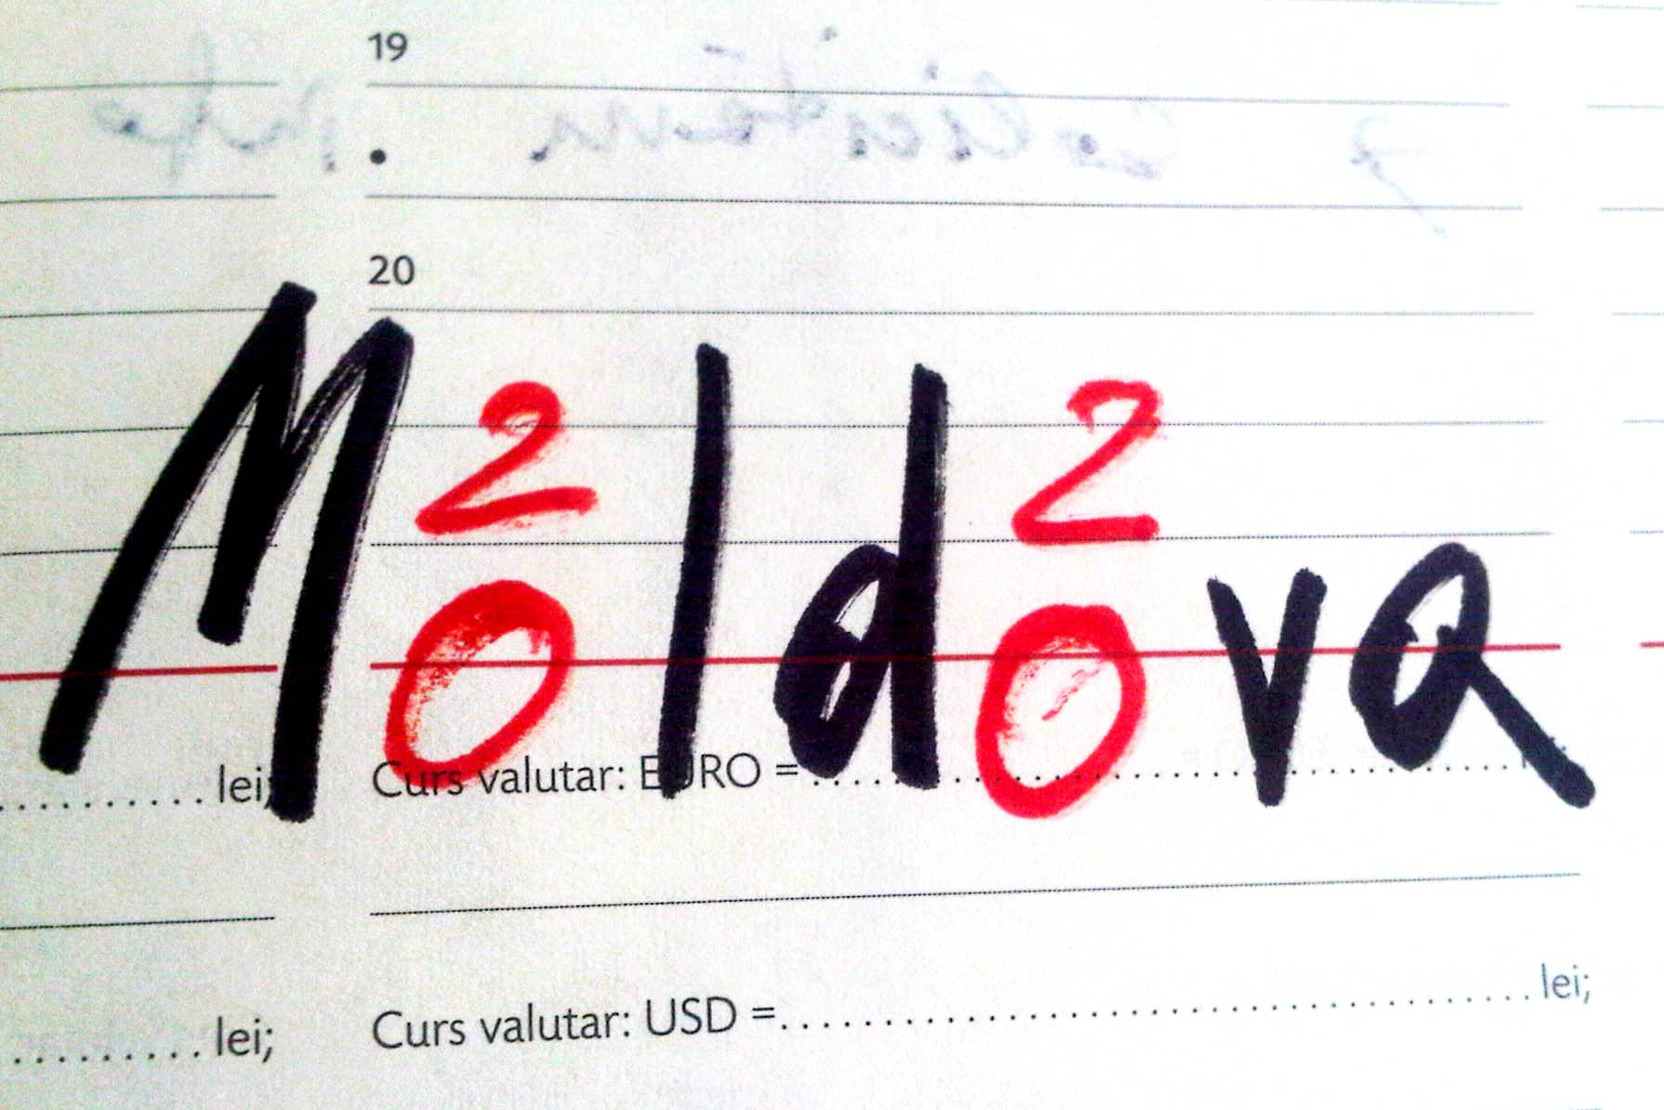
MOLDOVA–2020 - NATIONAL DEVELOPMENT STRATEGY which provides 7 SOLUTIONS FOR ECONOMIC GROUTH AND POVERTY REDUCTION

Slide 25
7 Solutions
Education – Relevant for a career
Roads – In good condition, anywhere
Finance – Affordable and cheap
Business - With clear rules of the game
Energy - Delivered safely, used efficiently
Pension system – Equitable and sustainable
Justice – Responsible and incorruptible

Slide 26
Measures provided for the implementation in the framework of the Central Public Administration reform, as well as in the framework of the “Public financial Management “ Project :
Development of an advanced financial management system, based on tools and mechanisms that meet the European standards.
Public financial management modernization is a necessary measure to eliminate the deficiencies in the process of management and administration of the public expenditure, such as:
incompatibility and separation of the databases,
lack of security and limited access to information for the prior periods,
inability to use the information or difficulties in obtaining the information in a timely manner,
limited capacity to assess the effectiveness of public sector expenditure.

Slide 27
The authority responsible for the implementation of the “Public financial Management "project is the Ministry of Finance, which is the project executive coordinator.
The beneficiaries of the project " Public financial Management " are: the Ministry of Finance, the Central Public Administrations (28), the Local Public Authorities of the second level (35), the Local Public Authorities of the first level (900), budget executors (2500).

Slide 28
The subject of the performance audit:
„ The achievements and shortcomings in the implementation of reforms in the area of public financial management, the possibilities of improving”.
The objective of the audit:
Implementation assessment of the "Public Financial Management " Project, as well as the achieved results from implementing an effective financial management system, based on modern instruments and mechanisms.

Slide 29
Identified Problems and deficiencies in the audit, that slow down the reforming process of this area :
The admitted delays in the development of financial management information system, affected the capacity to achieve some of the performance indicators associated with the use of the new information system, in order to provide new methodology in the budgeting process.
The development of a new law on public finances and fiscal accountability was completed with a delay, which affected the implementation of some activities stipulated by the reforms in the public financial management area.
Measures to improve the public financial management were insufficient for developing at the required level of institutional capacities regarding the budget development and execution, based on "programs and performance."
The quality and reliability of macroeconomic forecasts used to develop the budget were not improved as expected.

Slide 30
PARALLEL AUDITS
For the first time in the practice of the Court of Accounts in 2012, parallel audits were conducted with similar institution– The Chamber of Accounts of the Russian Federation, on the use of public funds allocated for the implementation in 2009 – 2011, of the economic cooperation program between the two countries, including those on the supply of food products to the Russian Federation from the Republic of Moldova.

Slide 31
Court of Accounts of the Republic of Moldova
www.ccrm.md
Angela Pascaru
e-mail: a_pascaru@ccrm.md

