Slide 1
6th Meeting of the INTOSAI Working Group on Key National Indicators
Austrian experiences about sustainability indicators in the field of demographic change

Slide 2
Content
Fiscal sustainability facing demographic changes
Scope of the audit
Lesson learnt

Slide 3
Fiscal Sustainability
Fiscal sustainability relates to the ability of a government to assume the financial burden of its debt currently and in the future
Fiscal sustainability indicators provide a firm basis to identify the size and the main source of risks to public finance sustainability in a long-term perspective

Slide 4
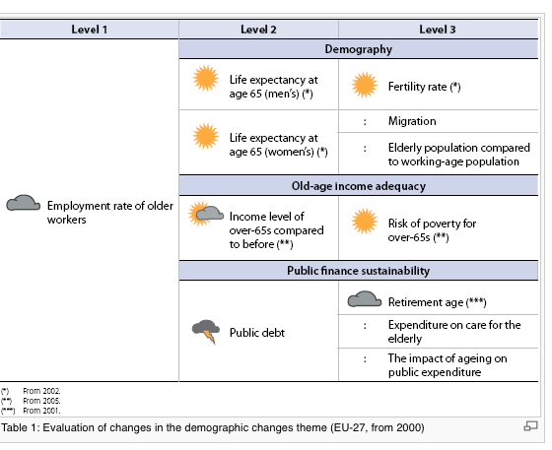
Sustainable Development Indicators (EU) Theme 4 - demographic changes
Source: EUROSTAT 2011

Slide 5
Public pensions expenditures as additional costs of an ageing population
Austrian Federal Financial Statement 2011
Public pensions expenditures: 25, 2 % of the total expenditures
pension expenditures for public servants 8 bn EUR
impact on fiscal sustainability

Slide 6
Scope of the audit
Performance audit on the impact of legal and HRM measures on the duration of employment
covers 3 ministries (interior, justice, labour and social affairs)
around 45.000 public servants
Focus on incentives for
the organization
the individual public servant

Slide 7
Audit procedure
Collection of data on all public servants* from 2008 until 2012
Analysis of the data
Share of different forms of retirement (e.g. inability to work, at legal retirement age)
Retirement age
Differences between e.g.
police and general administration officers
men and women
* including permanent civil servants and contractual staff

Slide 8
Lesson learnt I
Choice of the indicators influences process and results of auditing
Technical difficulties might influence the choice of the indicators
„Employment rate of older workers“ is not productive at institutional level

Slide 9
Lesson learnt II
Retirement age as starting point to bridge the gap between macroeconomic indicators and audits at institutional level
Recommendations for the ministries beyond simply „ raising the retirement age“ e.g.
Focus on „retirement because of inability to work“ (individual incentives)
Integrate financial responsibility and HRM as incentive for the organisations

Slide 10
Elisabeth Dearing
dearing@rechnungshof.gv.at
Phone: 0043 711 71 - 8814

