Slide 1
The OECD Better Life Initiative
Romina Boarini
Head of the Well-Being and Progress Section, OECD Statistics Directorate

Slide 2
Inspiration
Build on long-term OECD interest and expertise on measuring well-being and progress
Opportunity of OECD 50th Anniversary
Shift the emphasis from measurement to actionable well-being:
  Well-being focus in policy-making
  Connecting people with policies

Slide 3
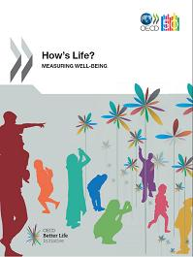

OECD Better Life Initiative
How’s Life report
First attempt at an international level to present comprehensive and comparable evidence on well-being
Your Better Life Index
A tool for learning what matters most for people’s well-being
Notes:
Build on long-term OECD interest and expertise on measuring well-being and progress
Shift the emphasis from measurement to actionable well-being:
Well-being focus in policy-making
Connecting people with policies

Slide 4
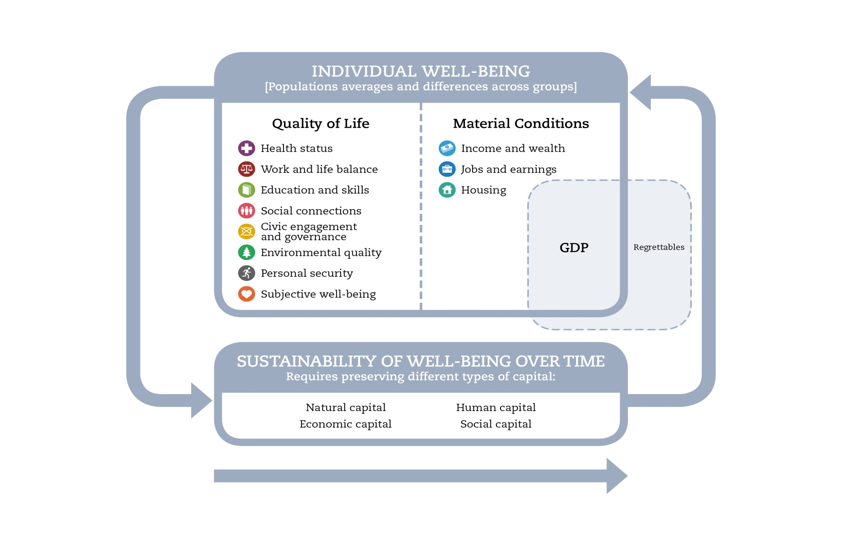
Defining well-being in the OECD Better Life Initiative
Notes:
What makes this framework unique…
Looking at people
Looking at inequalities
Looking at objective and subjective
Looking at outcomes

Slide 5
How’s Life? 2011
Method:
  Selection of headline (22) and secondary indicators (55)
  High quality statistical standards
  Consultation with experts and NSOs
  A dashboard with traffic lights, not a composite
Findings:
  Life in 2011 better than fifteen years ago
  But some lives are better than others
  No country is a champion in well-being
  Friends, family and jobs buy more happiness than money
Notes:
WE CAN SHOW CHARTS ON THIS IF NECESSARY…

Slide 6
Life got better but some lives are better than others

Slide 7
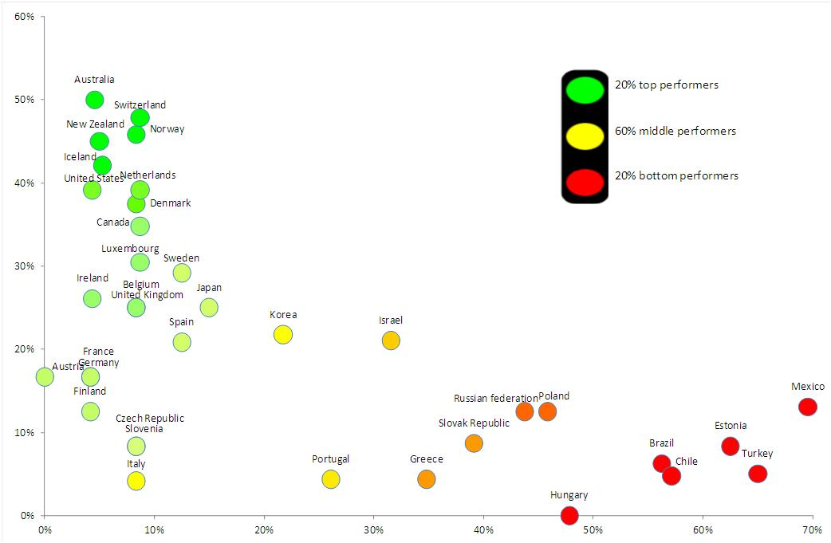
No country is a champion of well-being but some do better than others
% of green lights out of 22 headline indicators
% of red lights out of 22 headline indicators

Slide 8















Ongoing research programme
Setting new measurement standards
How should we measure happiness?
How should we measure social capital?
Understanding the drivers of better lives
What makes people happy?
What makes people satisfied with their job?
What makes home a “sweet home”?
Addressing challenges in measuring and understanding well-being:
How much freedom do you have in choosing your life?
How much money is worth one minute of your sleep?
Notes:
Coming up with evidence on Better Lives to inform policies
Three layers of evidence from the Initiative:
- Measures of Better Lives
- (Policy) Drivers of Better Lives
- People’s views of Better Lives

Slide 9
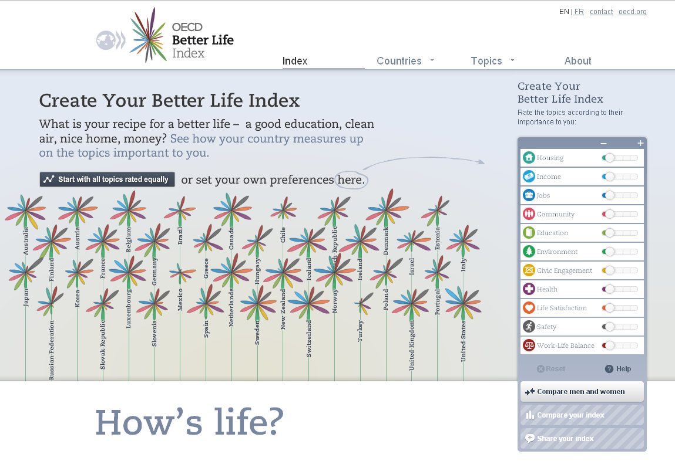
Your Better Life Index
Notes:
Live DEMO BLI
The rationale for the Index:
Involve all well-being actors into the evaluation of well-being and progress
Understand what matters to people
Feedback this information to policy-makers

Slide 10
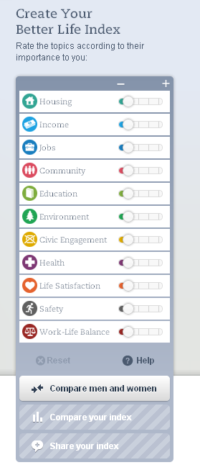
What we have learned from users
Global interest in project and findings
  Over one million visits from 180+ countries
  Over 38,00 indexes shared
Emerging trends
  Life satisfaction, Education and Health leading topics
  Men and women share priorities
  Respondents over 65 prioritise health and housing while 15-34 year olds focus on jobs
Cases of individuals using BLI to spark discussion and launch own local projects
Notes:
Cases of individuals using the BLI in more locally based projects:
For example:
Researchers Luc Godbout and Marcelin Joanis used OECD methodology to calculate the Better Life Index for Québec and compared the results with the Better Life Index of various OECD countries. The study was released in Canada by as part of Le Québec économique 2011, published by the Centre interuniversitaire de recherche en analyse des organisations (CIRANO). The study was mentioned by Raymond Bachand (Minister of Finance) in his Budget Speech to the National Assembly.

Slide 11
Collaboration with Russian Federation Account Chamber
Background:
RF accession to the OECD
OECD and INTOSAI collaboration in the context of the OECD Global Project
Steps:
RF regularly invited to OECD events
Anton Kosyanenko (RF AC) visited OECD HQ in early 2013
Joint WPs on topics of common interest

Slide 12
Enhancing the BLI for RF

Slide 13
Building time-series for the Russian BLI

Slide 14
Next steps of the Initiative
Next edition of How’s Life: September 2013, special focus: sustainability, gender and well-being, quality of jobs
Next update of the BLI: May 2013
Country monographs on well-being: How’s life in your country?
Policy implications of well-being measures: understanding determinants of well-being outcomes and their policy drivers
Statistical agenda:
  Guidelines on Measuring Subjective Well-Being
  Social capital
  Handbook on Income, Consumption and Wealth
  Regional indicators of well-being

Slide 15
How’s Life in Your Country?
Paint a broad picture of people’s life and well-being in the country considered
Provide the country with an analytical framework for conducting a “well-being diagnosis”
Identify the policy areas where the country should concentrate efforts to maximise the well-being of its citizens

Slide 16
THANK YOU!
romina.boarini@oecd.org
www.oecd.org/progress
www.oecdbetterlifeindex.org

