Slide 1
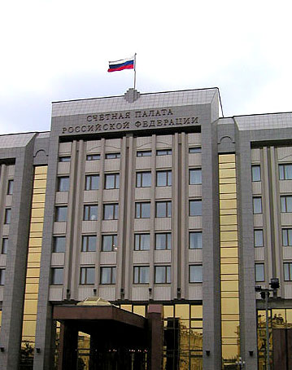
Accounts Chamber of the Russian Federation
Application of INTOSAI working group on KNI results to analysis of OECD Better Life Index
Anton Kosyanenko

Slide 2
Data quality issues
Data quality can be defined as “fitness for use,” a concept that includes a number of attributes that contribute to the usefulness of the data from the perspective of the users such as relevance, accuracy, credibility, timeliness, accessibility, interpretability and coherence.
Data quality is ensured through the implementation of verification and validation of data in order to avoid data limitations i.e. problems with the data sources or the data that may be identified by program evaluations, independent audits, information systems analyses, etc.
White Paper on Key National Indicators, p. 16

Slide 3
Russia through the lens of OECD Better Life Index
Position of Brazil and Russian Federation according to
OECD Better Life Index

Slide 4
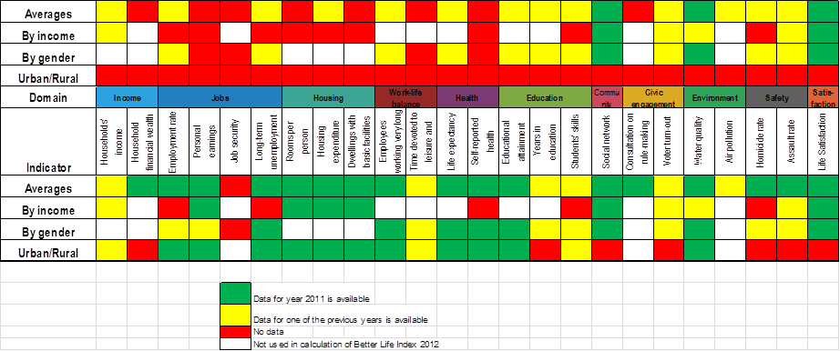
Enhancing the BLI for Russia

Slide 5
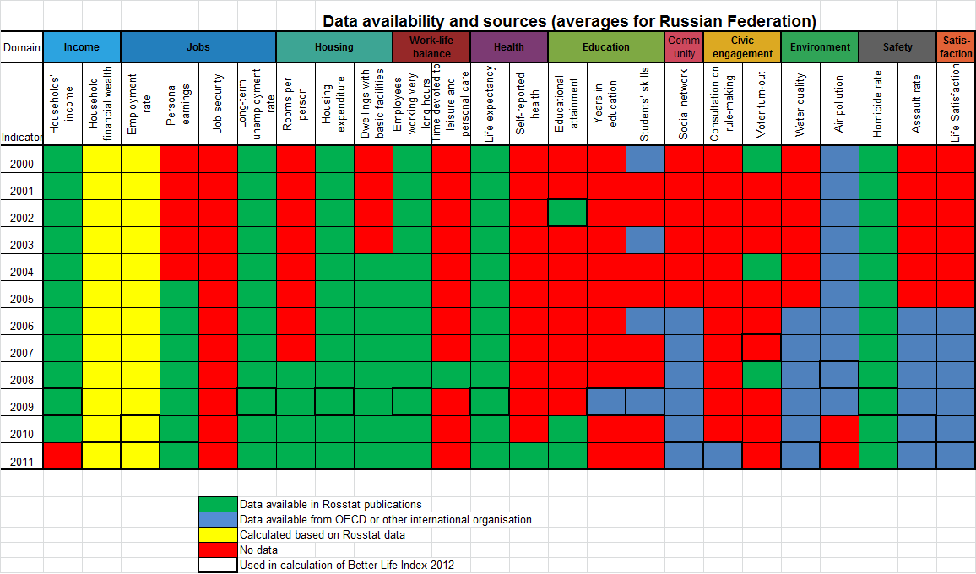
Building time-series for the Russian BLI

Slide 6
Results of BLI data review for Russia (indicator level)

Slide 7
Results of BLI data review for Russia (domain level)
Domains most important from a point of view of improving the balance of estimates

Slide 8
Liu G. Measuring stock of human capital for comparative analysis: an application of the lifetime income approach to selected countries. OECD Statistics Directorate. Paris. 2011. 49 p.
The meaning(s) of “social capital”:
a review of the literature and a proposed conceptual framework

Slide 9
Subjective measures of well-being
“Recommendation 10:
Measures of both objective and subjective well-being provide key information about people’s quality of life. Statistical offices should incorporate questions to capture people’s life evaluations, hedonic experiences and priorities in their own survey.”
Report by the Commission on the
Measurement of Economic
Performance and Social Progress

Slide 10
Balance of domains estimates
Axioms defining properties of composite indices:
Continuity (should be nonsensitive to small changes of the indicators)
Monotonicity (All indicators should increase people’s welfare)
Normalization (if all the indicators have the same value, then the index should also be equal to this value)
Weak homotheticity (rescaling by the same factor should not change ranking)
Strong homotheticity (rescaling by different factors for each indicators should not change ranking)
Anonymity (non well-being info should be irrelevant)
Cloning invariance (should be comparable across populations of different sizes)
Subgroup consistency (if the index values for two sub-populations change in such a way that they rise for one group and are unchanged for the other, then the index value of the whole population should rise)
Multidimensional essentiality if a focus is made on a sub-group of dimensions or on a sub-population instead of the whole sets, then the index should be independant of the choice of the resulting complementary subset
Multidimensional Pigou-Dalton smoothing (if a transfer occurs from a richer to a poorer unit, then the value of the index should increase)
Non-increasing comonotonic swaps (rearrangement of the achievements of two units, such that one gets the highest achievements in all dimensions and the other the lowest achievements should reduce the value of the index)
Axioms 1,2,3,4,6,7,8,9,10 hold only for the function
Nested Atkinson’s measure
Arithmetic mean
Atkinson’s measure
Geometric mean

Slide 11
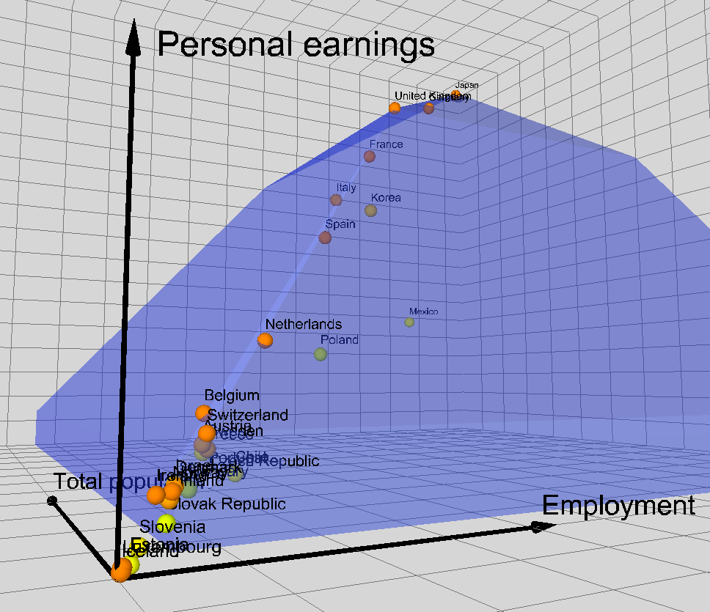
Application of Data envelopment analysis to BLI

Slide 12
Russia, where are you ripping to?
Policy targets vector
φ
Discrepancy
of development
vectors
θ
ω
People’s aspirations vector
Actual development vector
Russia 2011

Slide 13
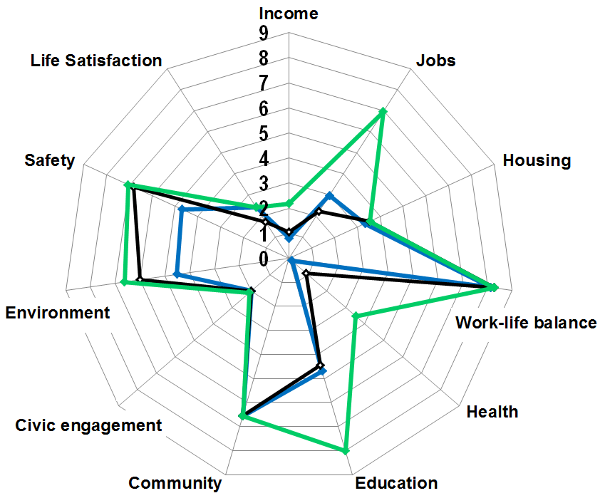
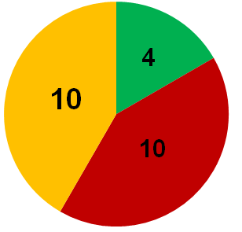
Estimating BLI based on Russian policy targets
Indicators that were computed on base of policy targets values
Indicators that were explicitly used as policy targets
Actual value of BLI in 2011
Estimation of BLI value
Indicators of OECD Better Life Index
 | 2008 | 2011 | 2018
Average assessment | 3,66 | 3,96 | 5,20
Assessments balance | 0,70 | 0,78 | 0,88
Indicators with values unchanged since 2011
Estimated policy target for 2018
Actual value of BLI in 2008

Slide 14
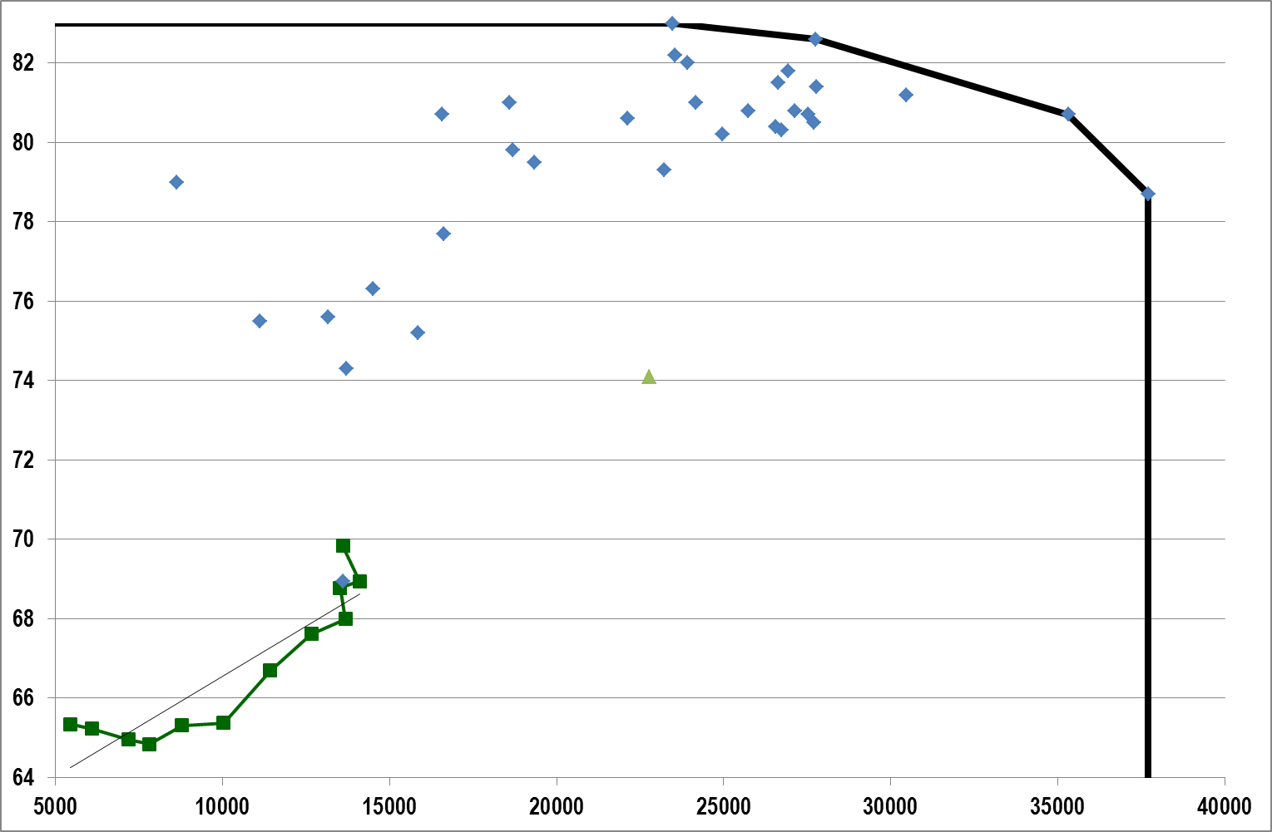
Development targets and trends
Japan 2010
Switzerland 2010
Luxembourg 2010
United States 2010
Policy targets to be achieved by 2018
Russia2011
Development trend line
Russia2000

Slide 15
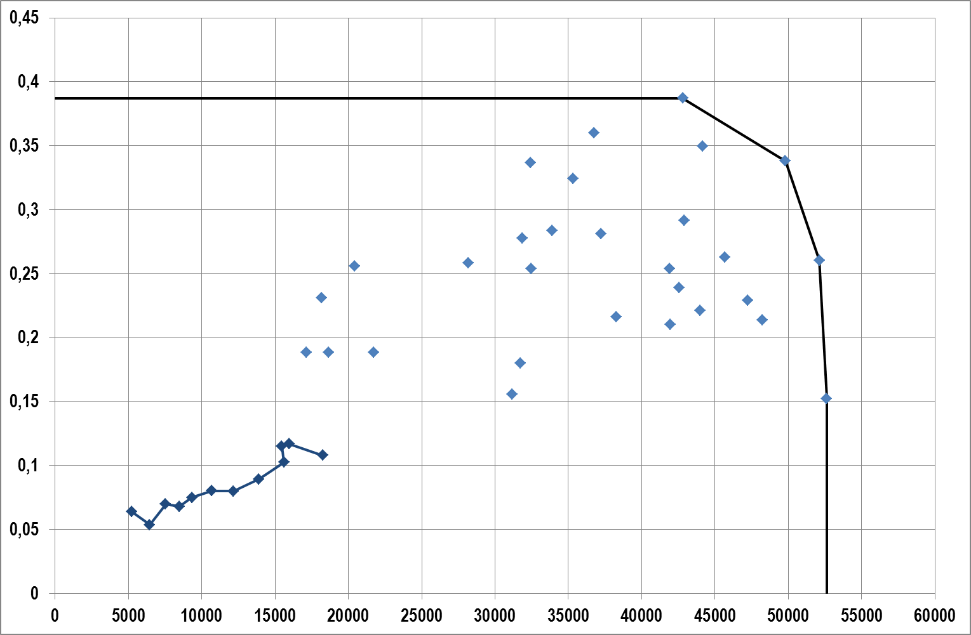
Average value and inequality in personal earnings
Belgium 2008
Switzerland 2010
Luxembourg 2010
United States 2010
Russia2011
Policy targets to be achieved by 2018
Russia2000

Slide 16
Main areas of possible cooperation between SAIs and OECD
Measuring progress in country X
“Russia through the lens of OECD Better Life Index”
Development of measuring instruments
In depth analysis of well-being and implications for policy making
“Where are you going, Russia?”

Slide 17
Accounts Chamber of the Russian Federation
Thank you!
Anton Kosyanenko
kosyanenko@ach.gov.ru
a.v.kosyanenko@gmail.com

