Slide 1
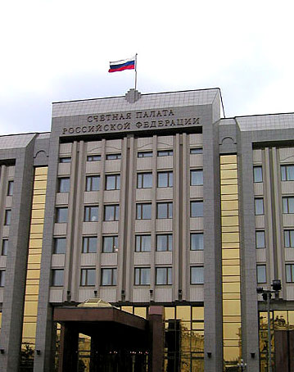
Accounts Chamber of the Russian Federation
Global imbalances analysis:
implications for KNI selection
Anton Kosyanenko

Slide 2
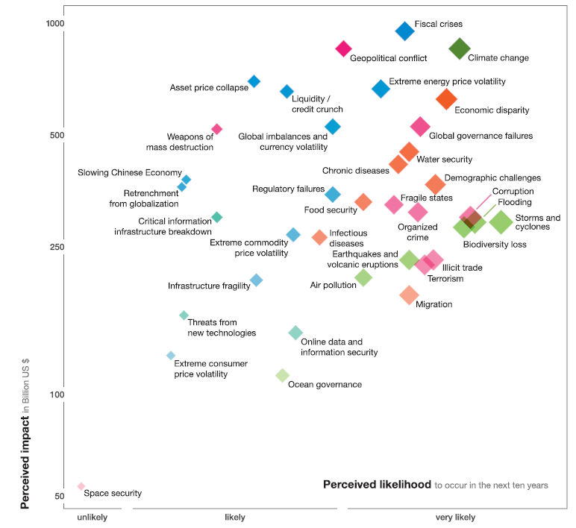
World Economic Forum global risks for 2011

Slide 3
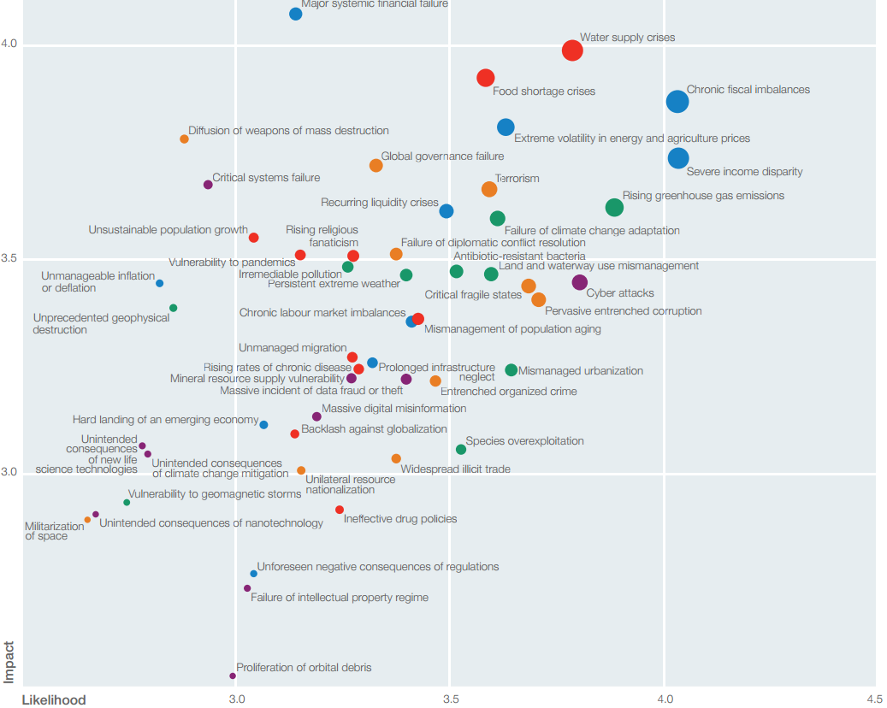
World Economic Forum global risks for 2012

Slide 4
Seul summit declaration includes obligation to
enhance the Mutual Assessment Process (MAP) to promote external sustainability. We will strengthen multilateral cooperation to promote external sustainability and pursue the full range of policies conducive to reducing excessive imbalances and maintaining current account imbalances at sustainable levels. Persistently large imbalances, assessed against indicative guidelines to be agreed by our Finance Ministers and Central Bank Governors, warrant an assessment of their nature and the root causes of impediments to adjustment as part of the MAP, recognizing the need to take into account national or regional circumstances, including large commodity producers. These indicative guidelines composed of a range of indicators would serve as a mechanism to facilitate timely identification of large imbalances that require preventive and corrective actions to be taken. To support our efforts toward meeting these commitments, we call on our Framework Working Group, with technical support from the IMF and other international organizations, to develop these indicative guidelines, with progress to be discussed by our Finance Ministers and Central Bank Governors in the first half of 2011

Slide 5
Key global imbalances indicators selected by G-20 working group
public debt
fiscal deficits
private savings rate
private debt
trade balance
net investment income flows and transfers.

Slide 6
INTOSAI White paper on Key National Indicators
5.1 SAI has as a part of this task also to evaluate validity, reliability, conciseness, completeness, independence and comparability of KNI used by the government and the information systems providing data to calculate the values of KNI.
6. SAI has to evaluate the disclosure of methods of calculations of KNI in order to assure transparency of KNI in use.
7. When working with KNI a SAI has to use general accepted and modern scientific methods within disciplines such as economy, statistics and social science and management science.

Slide 7
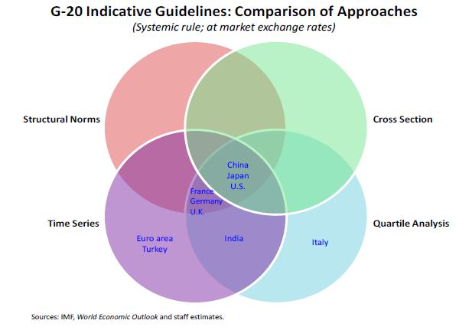
Countries selected by IMF staff as having large imbalances

Slide 8
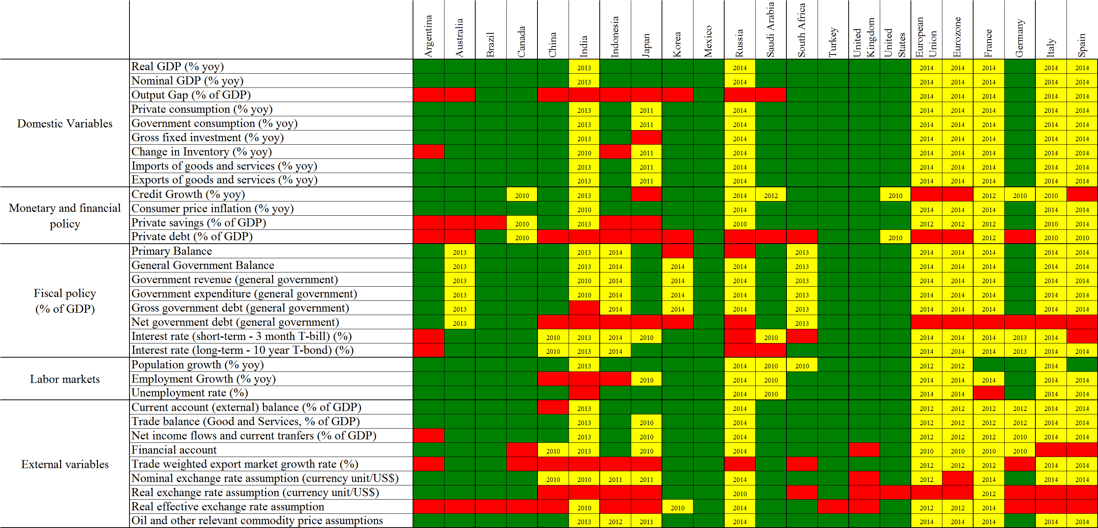
Composition and availability of information presented by G-20 members within Mutual Assessment Process

Slide 9
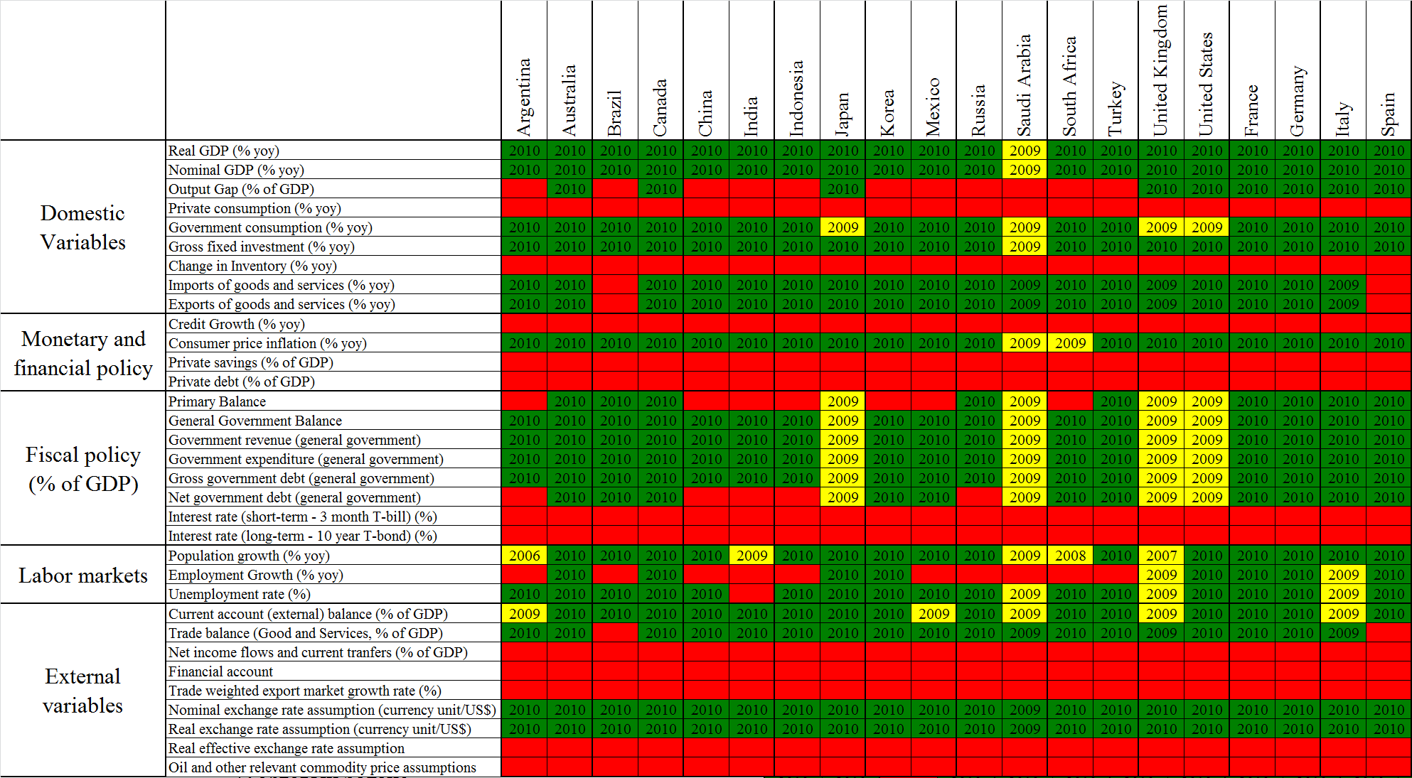
Data availability and delays for statistical data used within MAP

Slide 10
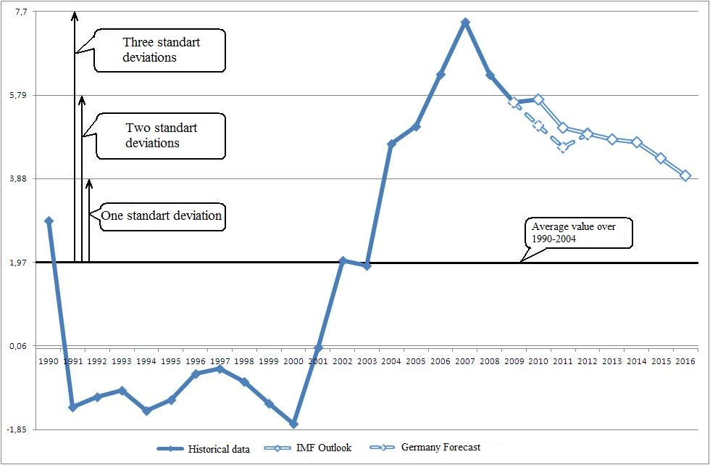
Selection of countries with large imbalances within MAP

Slide 11
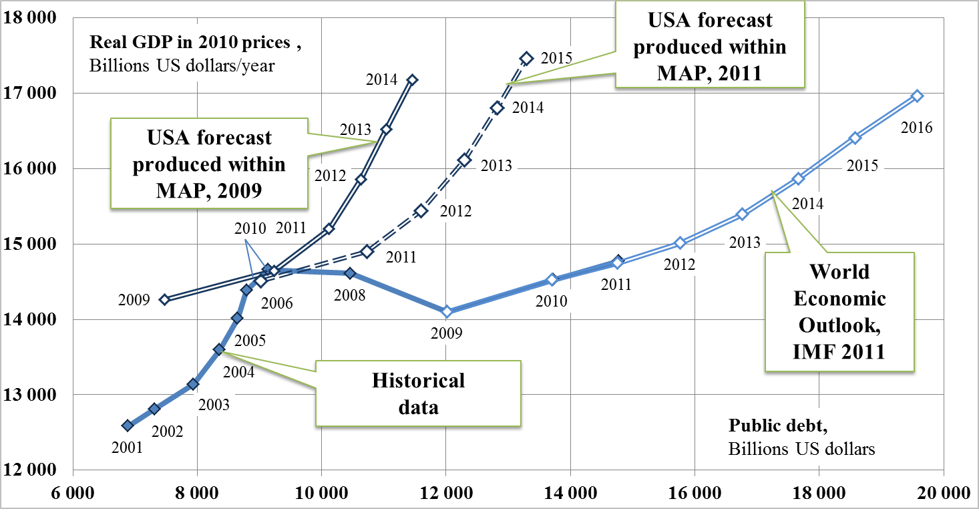
Results of USA imbalances assessment

Slide 12
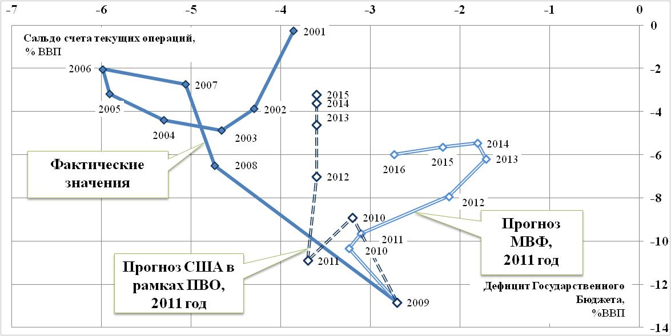
Results of USA imbalances assessment

Slide 13
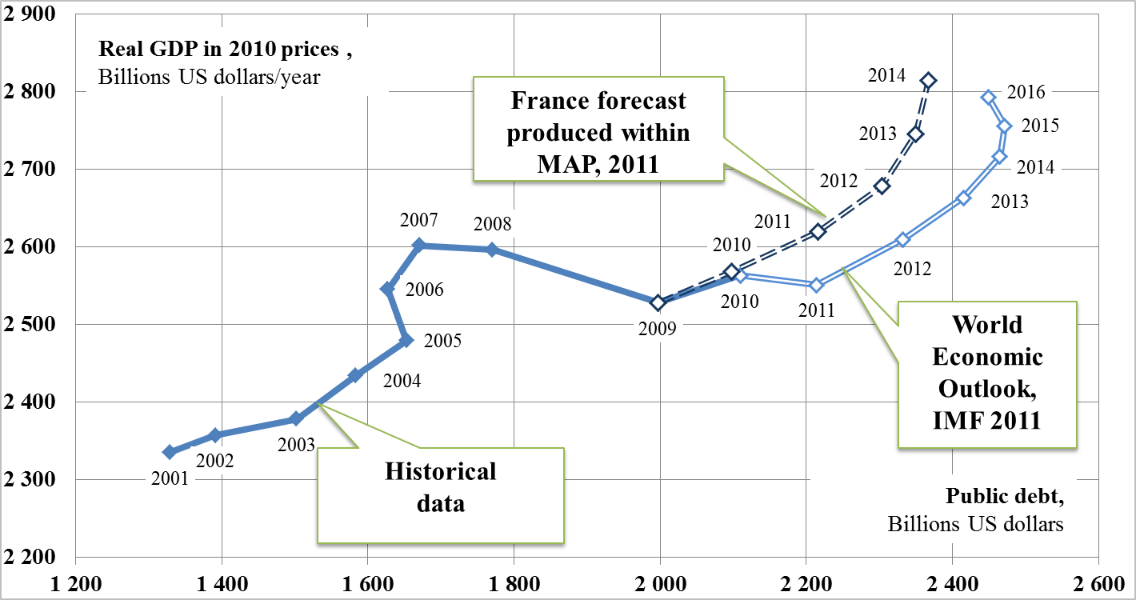
Results of France imbalances assessment

Slide 14
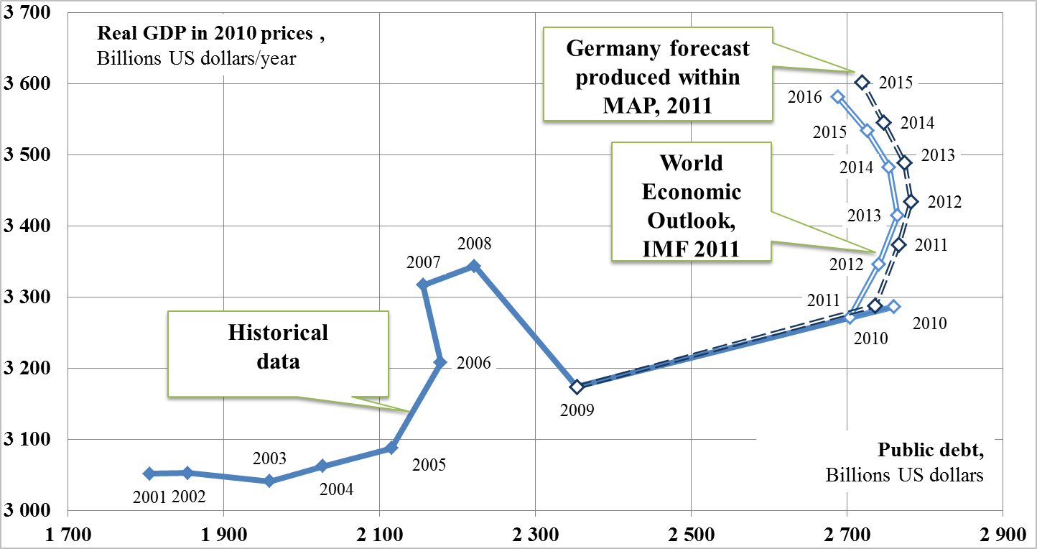
Results of Germany imbalances assessment

Slide 15
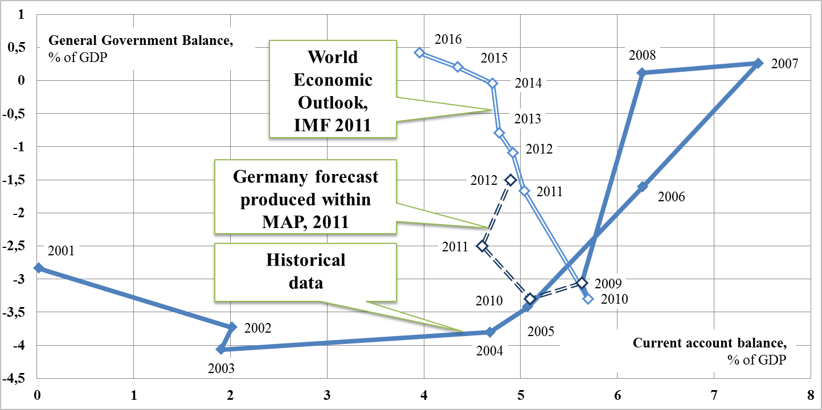
Results of Germany imbalances assessment

Slide 16
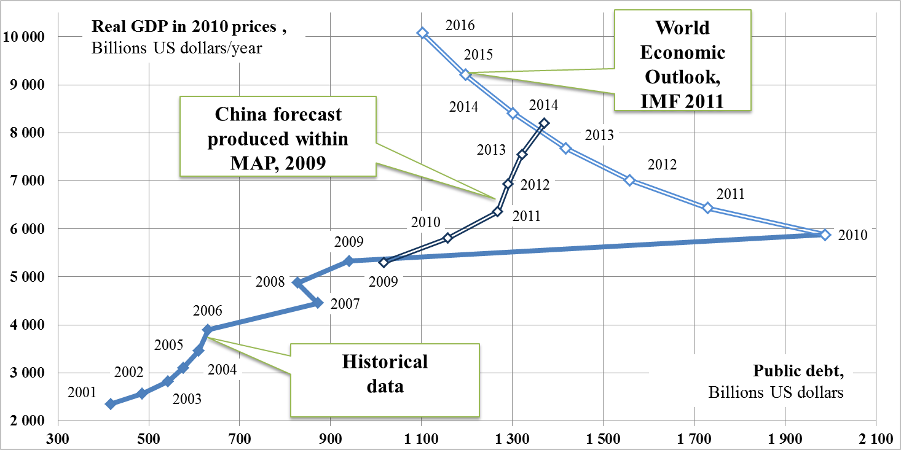
Results of China imbalances assessment

Slide 17
Analysis of terms applications and relation patterns
Государственный долг
(government debt, public debt,
national debt, sovereign debt)
Рецессия
(recession)
Долг частного сектора
(private sector debt)
Недостаток ликвидности
(lack of liquidity)
Перегрев экономики
(overheating economy)
Пузыри активов
(asset bubbles)
Совокупный долг
(gross debt)
Дефолт
(defolt)
Отток капитала
(capital outflow)
Приток капитала
(capital inflow)
Дефицит бюджета
(budget deficits)
Экспорт
(export)
Расходы
(expenditure)
Потоки капитала
(capital flows)
Инфляция
(Inflation)
Импорт
(import)
Бюджет
(budget)
Доходы
(revenue)
Торговый профицит
(trade deficit)
Торговый баланс
(trade balance)
Профицит бюджета
(budget surplus)
Торговый дефицит
(trade surplus)
Глобальные дисбалансы
(global imbalances)
Конкурентная девальвация
(currency war, competitive
devaluation, undervalued
exchange rate)
Протекционизм
(protectionism)
Кредит
(credit)
Резервы, сбережения
(reserves, savings)
Торговые войны
(trade wars)
Развитые страны
(developed countries)
Развивающиеся страны
(developing countries)

Slide 18
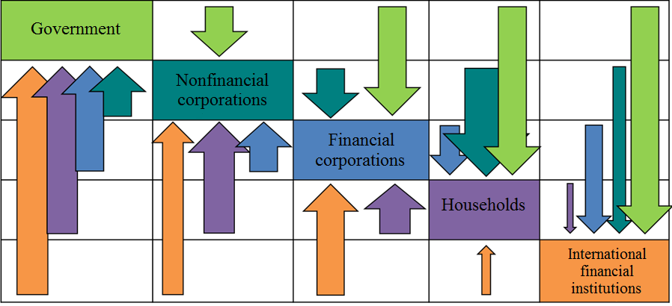
Balance of financial flows for key economic agents

Slide 19
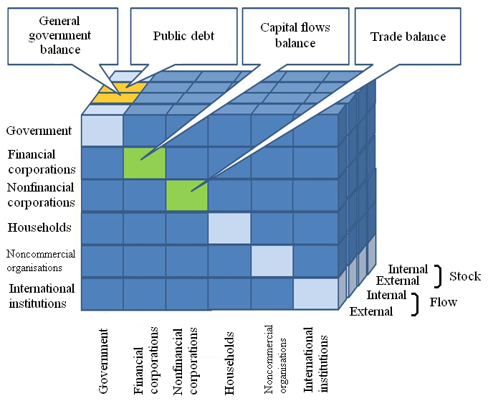
The area of factors of main socio-economic development disbalances modeling

Slide 20
Results and Conclusions
Analysis of the set of key indicators selected and results of G-20 Mutual assessment process aimed at revealing the nature of global imbalances and the root causes of impediments to their adjustment indicates the lack of transparency and coherence of applied techniques.
Composition of indicators, data quality and statistic techniques applied in order to assess key global imbalances do not correspond with the scale and complexity of problem in question. That’s why the recommendations prepared by the G-20 working group still suffer from the lack of quality and effectiveness.
Development of strategic planning and strategic audit techniques requires development of national statistics, forecasting and policy assessment methodologies. These results might also be applied for international comparisons.
Combined efforts of governments and expert society are needed to ensure effective selection of key national indicators and development of modeling techniques used for forecasts and strategic plans development.

Slide 21
Accounts Chamber of the Russian Federation
Global imbalances analysis:
implications for KNI selection
Anton Kosyanenko

