Slide 1
From the financial crisis to the debt crisis
Rigsrevisionen
(The National Audit Office of Denmark)
April 2012

Slide 2
Content
The development of the agenda of our working group
Different political agendas and policy requires different KNI
Set up a common audit methodology for different KNI
The requirements of this model is that it should be applicable for different types of KNI

Slide 3
Chance in the agenda of the working group
Starting point
the progress of the society
strategy for improving the living conditions
Interim theme
bail out of the financial sector and other industries
Actual theme
deficit on public sector budget
sovereign debt crisis
absence of economic growth
Future
aspiration of sustainable economic progress
avoiding social economic problems and social up raising

Slide 4
Breakdown of problems and solutions
New problems requires new KNI
What we are measuring is determined by
how we operationalize our concepts
which concetual frameworks we are relying on
which cognitative sheme are we using
Rating by a rating agency is an indicator on how to trust worthy a nation is.
There is a static and a dynamic dimension in each indicator.
Indicators is also lacking the dimension of distribution of wealth.
Notes:
KNI is only one moment and what is needed is a dynamic dimension

Slide 5
Audit of Key National Indicators
A KNI reflect one problem on the agenda
Development of method of auditing of KNI
Set op a audit process for KNI
A methodological framework for auditing KNI
Use of theoretical and methodological concepts as a basis for the audit strategy of KNI

Slide 6
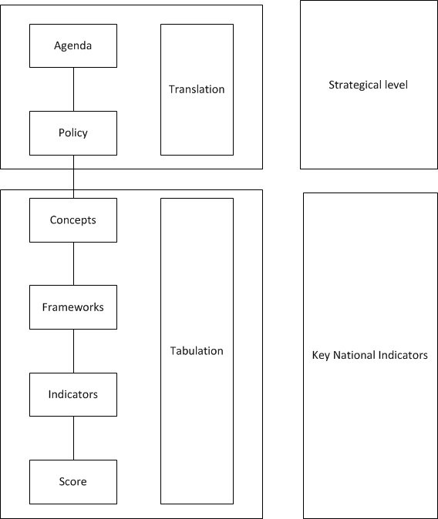
A scheme for
an audit model for KNI

Slide 7
Challenges within the model
Interfaces between the different phases in the translation and tabulation process
The translation from agenda to policy is a construction of governing principles
The tabulation is creating implementation tools for the policy

Slide 8
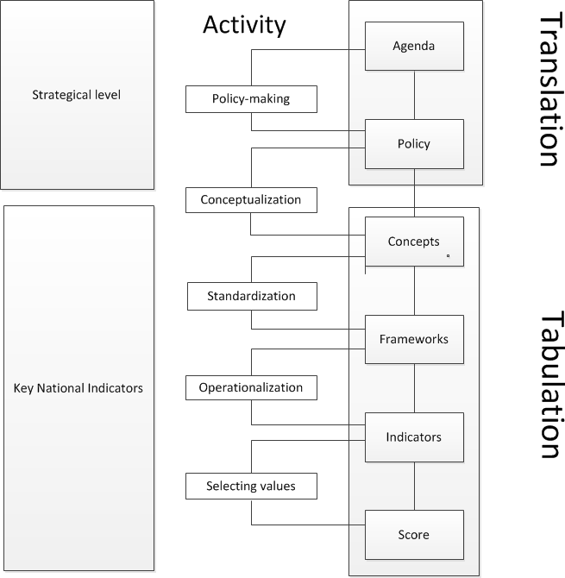

Slide 9
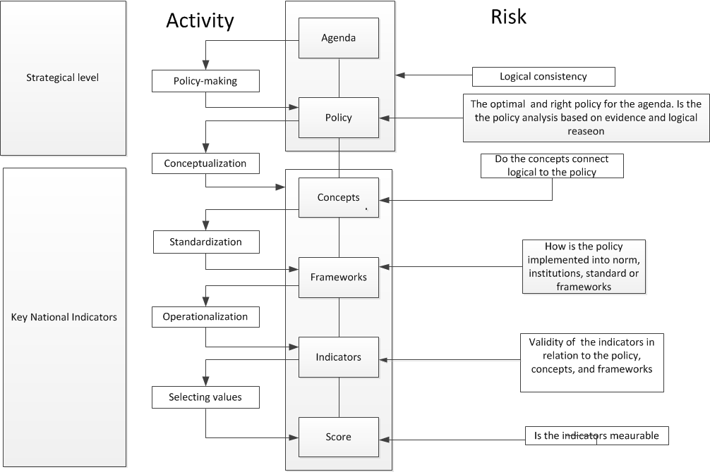

Slide 10
Criteria to evaluate KNI
validity
logic
capturing the content
contextual specificity

Slide 11
Cognitive Scheme
KNI reflects a specific cognitive scheme
The cognitive scheme are determined by the individual country’s priority of policy instruments which is depending on the political preference
Should the SAI have the capacity to analyze the cognitive scheme on which the chosen KNIs are based

Slide 12
Conclusion
Understand the agenda and the policy
governance context
the substance of the problem
Describe the policy process
How is the political agenda translated into a policy
Which concept is used for transformation the policy into a framework
The tabulation process from framework to indicators with relevant scares

