Slide 1
INTOSAI WORKING GROUP ON KEY NATIONAL INDICATORS
WORKING GROUP ACTIVITIES REPORT (2016 – 2017)
Dmitry Zaytsev
Accounts Chamber of the Russian Federation
Brasilia, Brazil, April 26, 2017

Slide 2
INTOSAI WORKING GROUP ON KEY NATIONAL INDICATORS
WORKING GROUP ACTIVITIES REPORT
9th MEETING OF THE INTOSAI WG ON KNI IN ARMENIA (TSAGHKADZOR) IN APRIL 2016
Analysis of opportunities on the use of KNI for international comparisons in the context of sustainable development and recommendations (SAI of Hungary)
Guidance document ‘Key National Indicators: Guidance for Supreme Audit Institutions’
New format of the Knowledge base on KNI
New subproject studying the issue of the government audits in the KNI framework

Slide 3
INTOSAI WORKING GROUP ON KEY NATIONAL INDICATORS
WORKING GROUP ACTIVITIES REPORT
REPORT ON THE INTOSAI WORKING GROUP ON KNI ACTIVITIES
8th INTOSAI KSC Steering Committee Meeting
(September 2016, Mexico)
68th INTOSAI Governing Board Meeting
(December 2016, Abu-Dhabi)
XXII INCOSAI
(December 2016, Abu-Dhabi)

Slide 4
INTOSAI WORKING GROUP ON KEY NATIONAL INDICATORS
WORKING GROUP ACTIVITIES REPORT
STANDARD ON AUDITING THE USE AND DEVELOPMENT OF KNI
draft of the Project proposal in accordance with the Due process for INTOSAI Framework of Professional Pronouncements (adopted at the Congress in December 2016 )

Slide 5
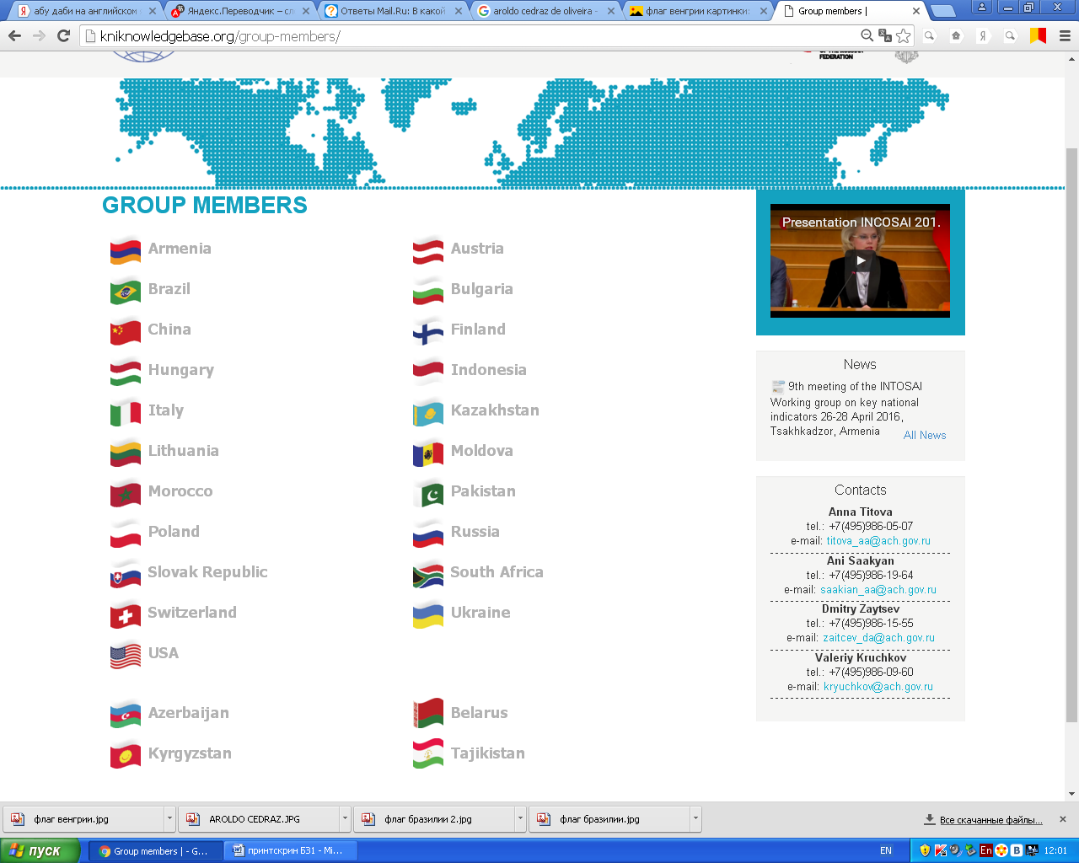
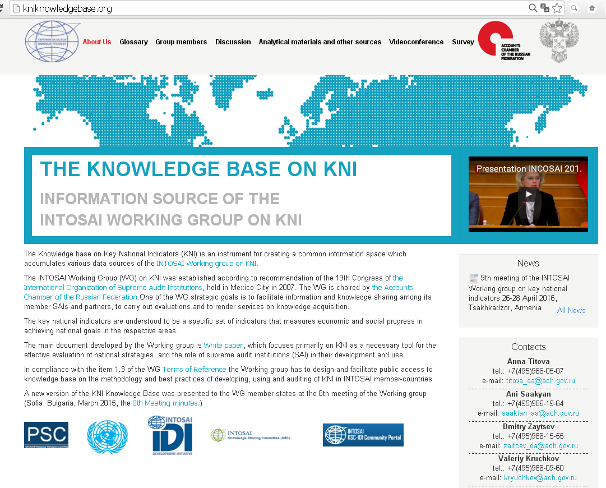
INTOSAI WORKING GROUP ON KEY NATIONAL INDICATORS
THE WORKING GROUP ACTIVITIES REPORT
KNOWLEDGE BASE ON KNI
kniknowledgebase.org

Slide 6
THE WORKING GROUP ACTIVITIES REPORT
INTOSAI WORKING GROUP ON KNI SUBPROJECT
Key National Indicator Systems and Public Governance (SAI of Brazil)
the title of the subprobject was defined and agreed upon
a tentative survey to evaluate the preparedness of governments and SAIs with regards to KNI and public governance

Slide 7
INTOSAI WORKING GROUP ON KEY NATIONAL INDICATORS
WORKING GROUP ACTIVITIES REPORT
9th MEETING OF THE EXPERT GROUP ON KNI OF THE CIS MEMBER-STATES
(KYRGYZSTAN, MAY 2016)
a new subproject aimed at knowledge sharing in the field of sustainable development goals
2 videoconference sessions with the members of the Expert group via the Knowledge base on KNI

Slide 8
INTOSAI WORKING GROUP ON KEY NATIONAL INDICATORS
WORKING GROUP ACTIVITIES REPORT
INTOSAI AND OECD
55th OECD Forum
(June 2016)
draft framework agreement between INTOSAI and OECD is at the stage of agreement within the OECD

Slide 9
INTOSAI WORKING GROUP ON KEY NATIONAL INDICATORS
WORKING GROUP ACTIVITIES REPORT
MAIN ACTIVITIES OF THE INTOSAI WORKING GROUP ON KNI IN 2017
starting the standard development
joining the efforts of SDG implementation
developing the Knowledge base on KNI
approving the draft framework agreement on cooperation between INTOSAI and the OECD
subproject “Key national indicators systems and public governance”
new subproject on the audit of macroeconomic forecasts

Slide 10
INTOSAI WORKING GROUP ON KEY NATIONAL INDICATORS
WORKING GROUP ACTIVITIES REPORT
THANK YOU!

