Slide 1
KEY NATIONAL INDICATORS, SUSTAINABLE DEVELOPMENT GOALS (SDGs), AND ROLES OF THE SUPREME AUDIT INSTITUTION IN INDONESIA
The Audit Board of the Republic of Indonesia
BRASILIA, April 26th 2017

Slide 2
agenda
Why this topic important?
Relationship between Key National Indicators and Sustainable Development Goals;
What sai Indonesia have done in implementing SDG with regard to KNI;
Lesson learned.

Slide 3
INCOSAI XXII IN ABU DHABI, UAE (2016)
THEME I - SDGS
THEME II - PROFESIONALIZATION
4 approach
Approach I
Approach II
Approach III
Approach IV
Assessing the preparedness of national governments to implement, monitor and report on progress of the SDGs, and subsequently audit their operation and the reliability of the data they produce
Undertaking performance audits that examine the economy, efficiency, and effectiveness of key government programmes that contribute to specific aspects of the SDGs
Assessing and supporting the implementation of SDG 16 which relates in part to effective, accountable, and transparent institutions
Being models of transparency and accountability in their own operations, including auditing and reporting

Slide 4
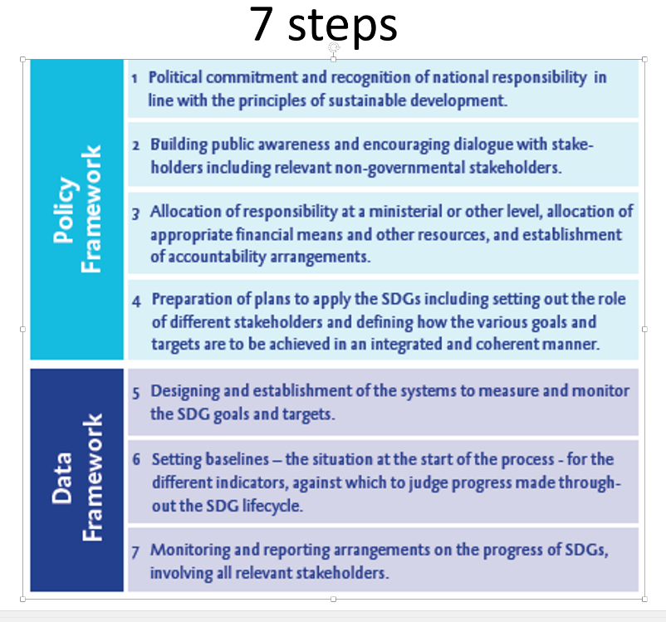
Approach I :
Assessing the preparedness of national governments to implement, monitor
and report on progress of the SDGs, and subsequently audit their operation
and the reliability of the data they produce
Planning
Measurement
Conducting
Baseline
Reporting
Indicator
Follow Up

Slide 5
KEY NATIONAL INDICATORS AND SUSTAINABLE DEVELOPMENT GOALS IN INDONESIA
Development Norm
Develop people and communtiy;
Improve welfare, prosperity and productivity , reduce income inequality, and focus on low and middle class productivity improvement, without hampering and reducing high class players as agents of development.
Develop without environment distruction, and without reducing evironment support and ecosystem balance.
Development Dimensions
People
(31 Indicators)
Prioritised Sectors
(92 Indicators)
Equality and Regions
(38 Indicators)
Education
Food Security
Income
Health
Energy & Electricity
Regions :(1) Villages, (2) Outer , (3) Non Java, (4) Easter
Housing
Maritime
Mentality/character
Tourism & Industry
Necessary Conditions (35 Indicators)
Rule of Law
Stability
Politic & Decmocracy
Governance & Bureaucratic Reform
QUICK WINS & PROGRAMS

Slide 6
BPK STRATEGIC PLAN WITH REGARD TO KNI AND SUSTAINABLE DEVELOPMENT GOALS
THEMES OF AUDIT IN BPK STRATEGIC PLAN 2016-2020
CROSS DIMENSION
Economic and Public Finance
DIMENSION OF HUMAN DEVELOPMENT
DIMENSION OF PRIMARY SECTOR DEVELOPMENT
DIMENSION OF EQUALIZATION
EDUCATION
FOOD SOVEREIGNTY
AMONG INCOME GROUPS
HEALTH
SOVEREIGNTY ENERGY AND ELECTRICITY
AMONG REGION : (1) VILLAGE, (2) BORDERS, (3) OUTER,
(4) EASTERS REGION
HOUSING
MARITIME AND
MARINE
MENTAL/CHARACTER
TOURISM AND
INDUSTRY
NECESSARY CONDITION
CERTAINTY AND LAW ENFORCEMENT
SECURITY AND
ORDER
POLITICS AND
DEMOCRATIC
GOVERNANCE AND
REFORM

Slide 7
Bpk audit focus 2016-2020
Dimension | Themes | Focus
A. Macro Economic Development | National and Financial Economic Programs | a. Audits on Economic and Bureaucratic Reform Programs
 |  | b. Audits on Promoting Productivity and Competitiveness of State Owned Enterprises
B. People | 1. Health | Audits on national health insurance and programs
 | 2. Education | a. Audits on 12-year Compulsory Education Program
 |  | b. Audits on Teacher Quality Improvement Programs
 |  | c. Audits on Higher Education Access Programs
 | 3. Character and Mentality | Audits on Government National Character Improvement Programs
 | 4. Family Planning & Demography | Audits on Family Planning and Demography Programs
C. Prioritized Sectors | 1. Food Security | a. Audits on Food Production and Diversification Programs
 |  | b. Audits on Supporting Infrastructure for Food Security Programs
 | 2. Energy Security | Audits on Energy Supply Availability Programs
 | 3. Maritime | Audits on Maritime and Connectivity Programs
D. Equality of Income and Regional Development | 1. Regional Development | a. Audits on Village Development Programs
 |  | b. Audits on Border Areas Development
 |  | c. Audits on National Connectivity
 | 2. Income Equality | Audits on Poverty reduction Programs
E. Necessary Conditions | 1. Defense and Security | Audits on National Defense and Security Programs
 | 2. Governance & Buraucratic Reform | Audits on Public Services Programs

Slide 8
WHAT WE HAVE DONE
a. 2015
Audit of Provincial and Districts Government Development Plans
Audit of Health and Education Services
Audit of Poverty Reduction Program
Audit of State Financial Reform
b. 2016
Audit of Provincial and Districts Government Development Plans;
Audit of Fulfillment of Facilities for Basic and Mid Level Education;
Audit of Family Planning – Population control;
Audit of Health services;
Audit of Employment – Indonesian workers in foreign countries.

Slide 9
WHAT WE FOUND IMPORTANT
Results of Audits of Government Planning in 2015 and 2016 shows that:
Ineffective control and evaluation of the implementation of the Provincial Government Plan to synchronize with the changes made in Central Government Plan (2015);
Several Provincial Government Plans audited have not yet set certain performance indicators and targets which makes it difficult to measure the achievement level (2015);
Most of the audited entities have not yet performed an evaluation whether their Government Plans have conformed with the National Government Plan (2016);
Inconsistency in terms of programs, goals, targets, strategy and performance indicators between the Government Plan and its Annual Working Plans (2016).

Slide 10
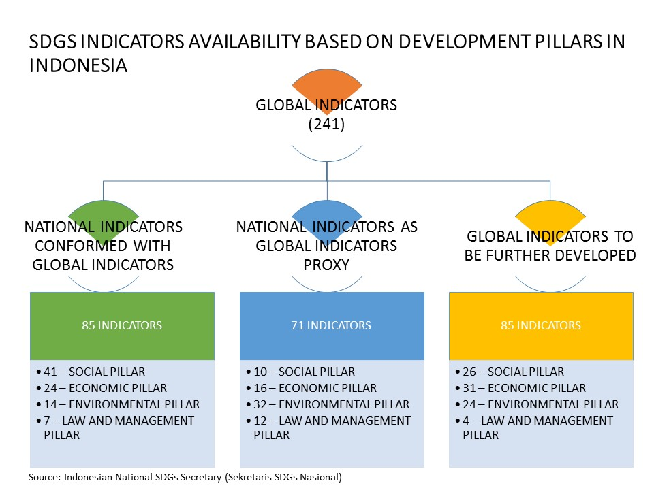
What we have learned FOR FUTURE IMPLEMENTATION OF SDGS
The importance to assess the Preparedness of Governments especially in terms of data – settled baseline, Proper measurement and Proper indicators;
The example of Indonesia :

Slide 11
THANK YOU FOR YOUR ATTENTION
The Audit Board of the Republic of Indonesia (BPK)
Jl. Gatot SubROtO KAV. 31 Jakarta Indonesia 10210
Website: www.bpk.go.id
Telephone: +62-21-2554-9000 EXT 1183
Facsimile: +62-21-57953198

