Slide 1
Reliability of macroeconomic forecasts
Ville Vehkasalo
INTOSAI Working Group on
Key National Indicators
Brasília, 26.4.2017

Slide 2
Contents
Motivation for the audit
Questions and criteria
Main findings and recommendations

Slide 3
Reliable macroeconomic forecasts are essential for successful fiscal policy

Slide 4
Motivation
The aim of this audit was to determine whether the organization, methods and reporting of the forecasting work are in accordance with the legislative requirements
The aim was also to determine whether the macroeconomic forecasts prepared by the Ministry of Finance give a true and fair picture of the economy

Slide 5
Questions and criteria
1) Are the Ministry of Finance’s macroeconomic forecasts statistically reliable?
Criteria: statistical inference; statistical tests

Slide 6
Questions and criteria
2) Are the forecasting processes and methods of the Ministry of Finance properly explained and described in an open and transparent manner?
Criteria: Budgetary Frameworks Directive (2011/85/EU), recommendations based on IMF and OECD reports

Slide 7
Questions and criteria
3) Is the forecasting work in the Ministry of Finance organised and managed so that the requirement for independence is met?
Criteria: EU legislation, reliability of the findings, openness of documentation, best practices of the independent organization of activities

Slide 8
Economic forecasts produced by the Ministry of Finance are statistically reliable

Slide 9
Main findings
Macroeconomic forecasts prepared by the Ministry of Finance are not statistically biased
There is no difference between the accuracy of the economic forecasts produced by the Ministry of Finance and those published by other forecasting institutes

Slide 10
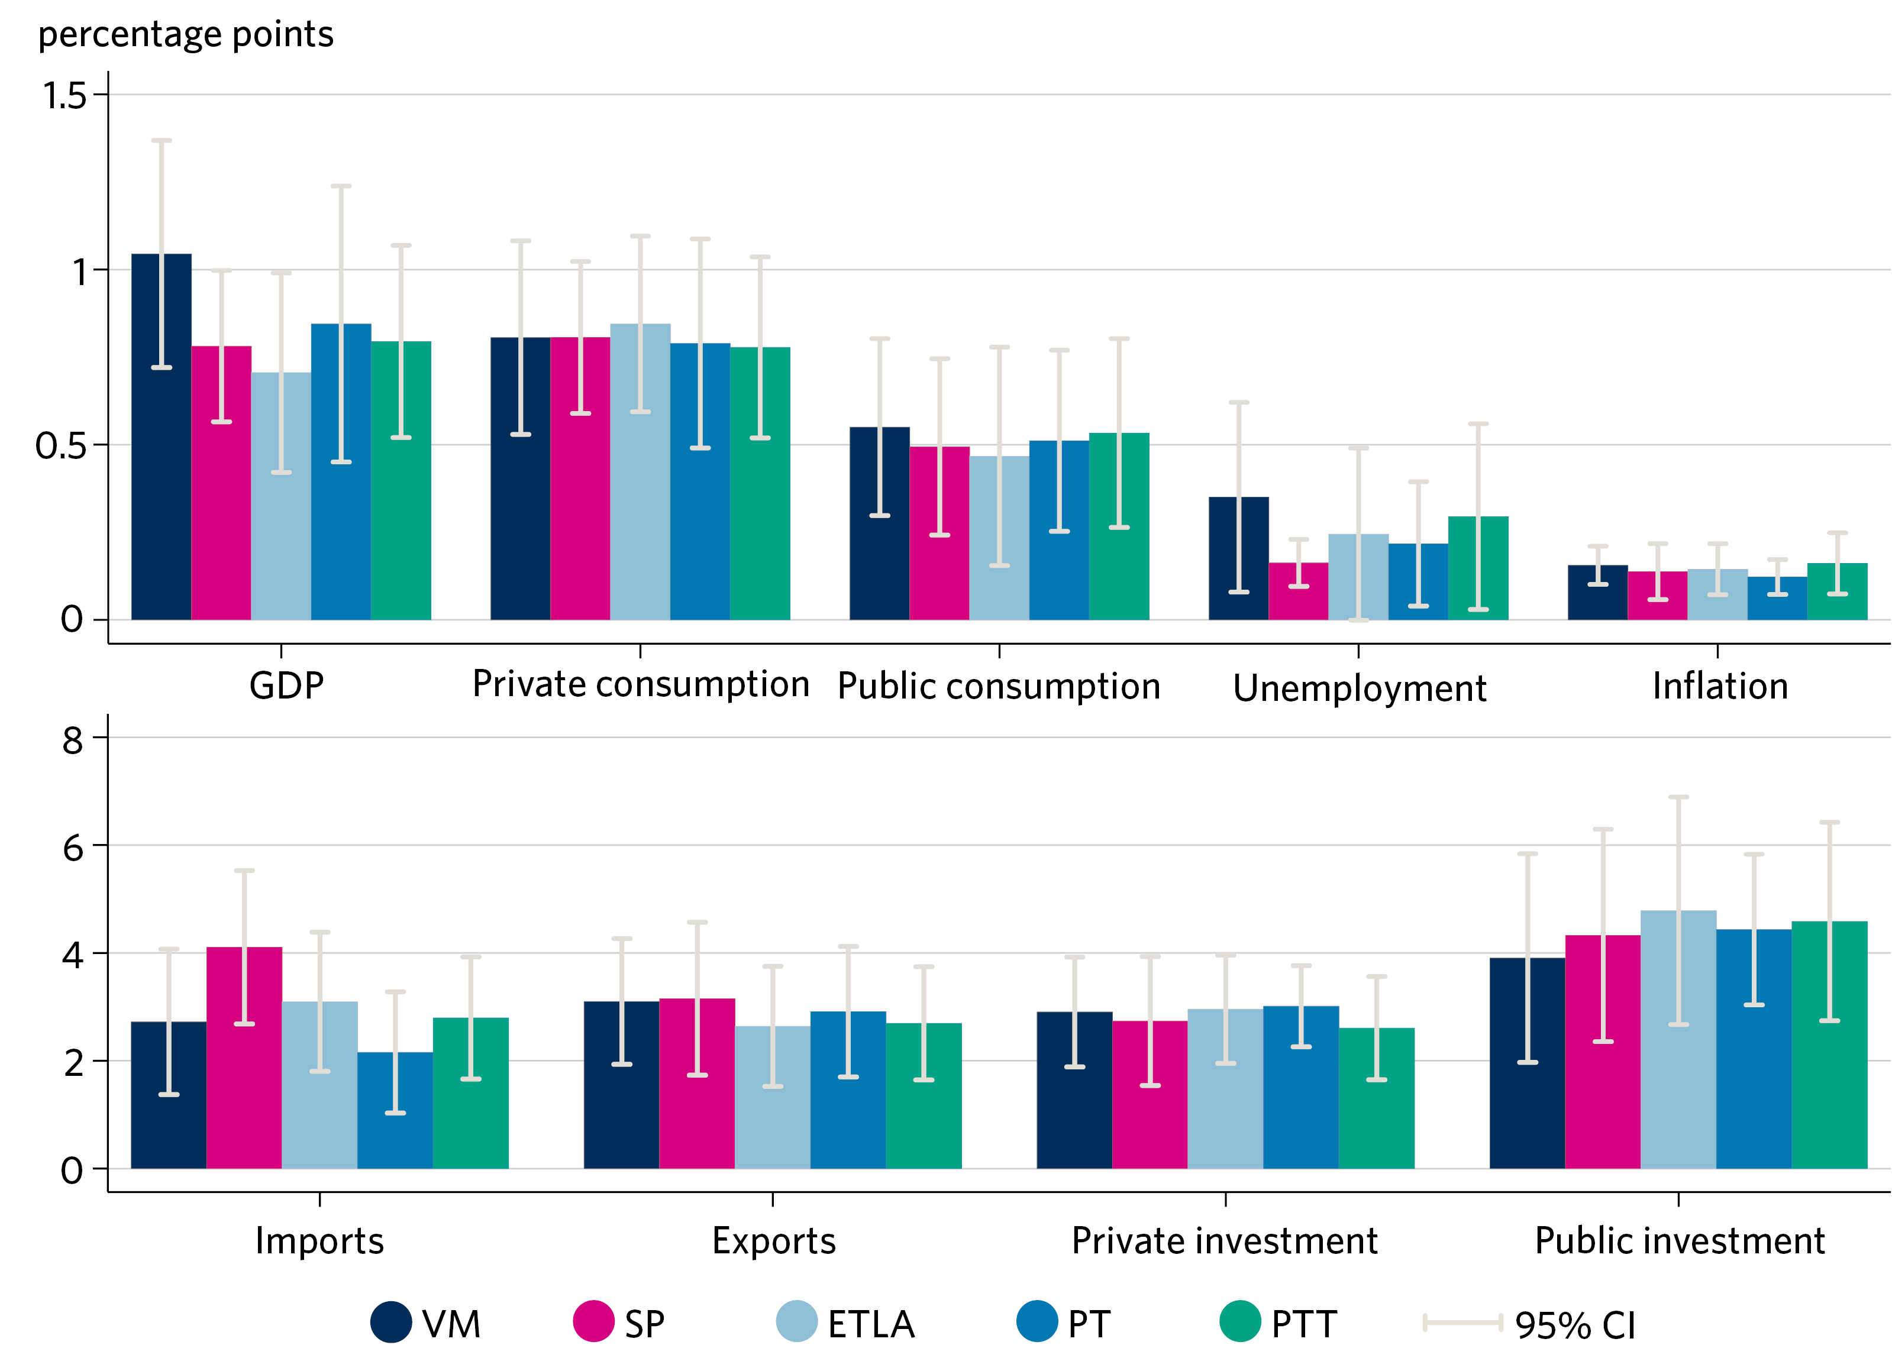
Average absolute value of the forecast error (t+0) produced by different forecasting institutes between 1997 and 2014

Slide 11
Main findings
The preparation of the forecasts is poorly documented
Risks contained in the forecasts are not described in a comprehensive and clear manner
Forecasting by the Ministry of Finance is not fully transparent

Slide 12
Main findings
Independence of the forecasting by the Ministry of Finance is based on national legislation
Fiscal forecasts are prepared in close cooperation with budgetary authorities
Public communication is carried out in a timely manner

Slide 13
There should be more focus on ensuring that the forecasts are seen as reliable by outsiders

Slide 14
NAO’s recommendations
The forecast errors in the forecasts produced by the Ministry of Finance should be analyzed and published on a regular basis
The Ministry of Finance should produce a systematic documentation of the methods
Strengthening and highlighting the independent nature of the forecasts

Slide 15
Thank you!
For details, see NAO Finland’s fiscal policy audit report 11/2016 (also in English)
https://www.vtv.fi/files/5277/11_2016_Reliability_of_macroeconomic_forecasts.pdf
Further information from the fiscal policy
auditor in charge, Mr Ville Haltia,
ville.haltia@vtv.fi

