Slide 1

Subproject
KNI and Governance
Minister Augusto Nardes
Federal Court of Accounts of Brazil (TCU)
Notes:
Anexa minuta de apresentação a ser feita pelo Ministro Nardes durante a 10ª Reunião do WG/KNI.
A ideia é que ele:
- fale de governança, os 6 primeiros slides (2 a 7) são da última apresentação que o Ministro fez
- fale da importância do centro de governo (slide 8)
- explique rapidamente como surgiu o subprojeto e a pesquisa
- apresente alguns resultados da pesquisa
- proponha a identificação de boas práticas como próxima etapa do subprojeto.

Slide 2
KNI and Governance
Leadership
Decision-making
Long-Term Planning
Governance
Strategy
KNI
Coherence
Monitoring
Control

Slide 3
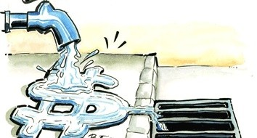

Why improve governance?
Efficient use of public resources
Avoid diversion, frauds and corruption
Deliver quality services to citizens

Slide 4
GOVERNANCE X CORRUPTION
Improvement of public governance will allow tools such as strategic planning, risk management, internal and external control, and accountability, among others, to inhibit practices that may cause damage to the “shareholders” of public well-being, which is society, to the benefit of private groups or of public agents and government officials themselves.
(PUBLIC GOVERNANCE: BRAZIL’S CHALLENGE)
Notes:
GOVERNANCE AGAINST CORRUPTION
I have always advocated the importance of good governance so that the State and society can be more effective in combatting corruption.
In the book GOVERNANÇA PÚBLICA: O DESAFIO DO BRASIL (Public governance: Brazil’s challenge), I stated that:
Improving public governance will allow tools such as strategic planning, risk management, internal and external control, and accountability, among others, to inhibit practices that may cause damage to the “shareholders” of public well-being, which is society, to the benefit of private groups or of public agents and government officials themselves.
WE CAN CONSIDER CORRUPTION AS ONE OF THE CAUSES AND ONE OF THE CONSEQUENCES OF BAD GOVERNANCE.

Slide 5
Governance Practices
  Choosing leaders with criteria – including from councils
  Leadership capacity-building and evaluation
  Strategic Plan - Objectives, goals and indicators
  Participation of society and stakeholders
  Coordination and cooperation
  Independent Internal Control Internal Audit
  Risk Management and Control mechanism
  Transparency and accountability
  External Control
Notes:
Governance is a set of good leadership practices, strategy and control.
And what are the main practices?
Some of them can be seen in the slide. In the next slide, you will see some governance reference guides produced by TCU in which an extensive set of these practices were catalogued.
All of these practices, in addition to enabling better understanding of the demands of society and ensuring more effective delivery of these demands, are essential for preventing and combatting corruption.
Any criminal organization that targets corruption seeks to move away from these practices. For example, this happened in Petrobrás. To enable corruption, the first thing one does is place people in leadership positions that will focus on the criminal object instead of on the “main” interest of the owner.
If you draw up a strategic plan and establish objectives, goals and indicators, based on evaluation of possible scenarios, and combine this with good analysis and risk management, investment in refineries would be so high, as was the case in Petrobrás, making embezzlements of billion possible.
Another important practice to inhibit corruption is, certainly, transparency and accountability. By privileging secrecy and confrontation with control agencies, as Petrobrás did, a more favorable enviroment for embezzlement and criminal practices is created. Transparency and accountability are also essential for the control of society and stakeholders.

Slide 6
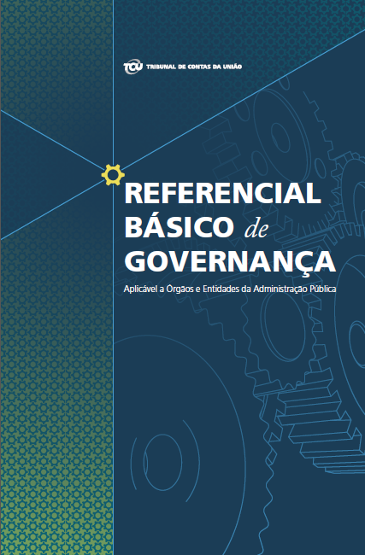
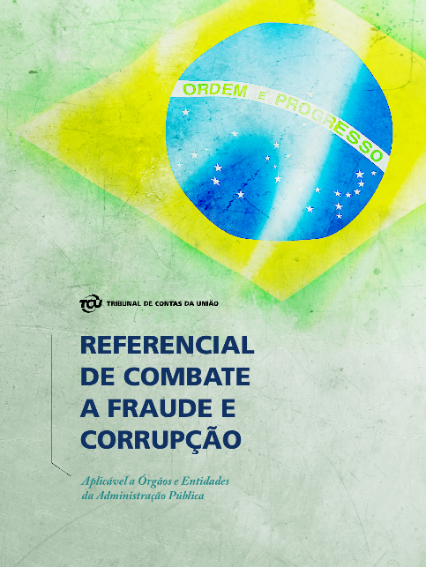
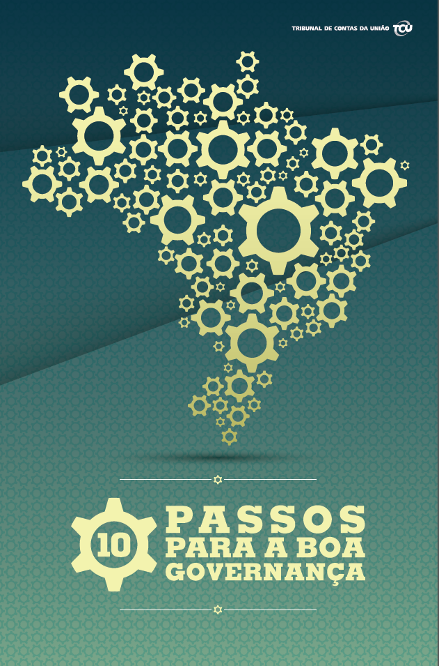
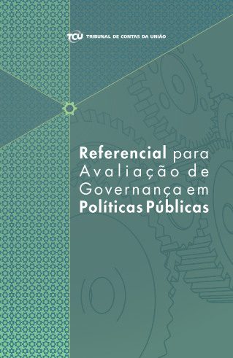
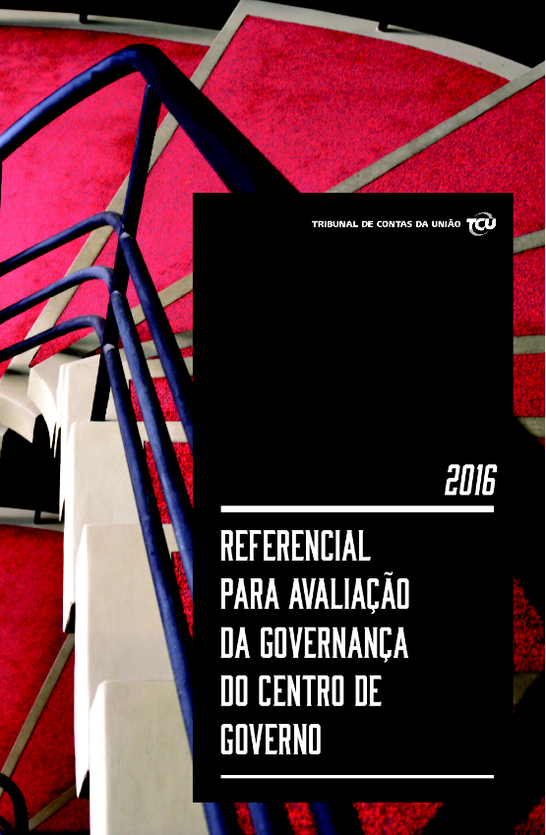
TCU Governance Reference Guidebooks
From paper to practice
Notes:
As I said, in order to cooperate with the improvement of governance throughout the country, TCU elaborated and published four reference guides:
Basic Governance Reference Guidebook
Ten Steps to Good Governance.
Public Policies Reference Guidebook (OECD)
Reference Guidebook for Evaluating Governance in Center of Government
Reference Guidebook on Combatting Fraud and Corruption.

Slide 7
Public Governance Indicator in Brazil - IGG
Define a general governance indicator to federal, state and local agencies and organizations
Based on the Basic Governance Reference Guidebook
7 thousand public administration organizations were interviewed
based on three governance mechanisms – leadership, strategy and control
Notes:
Harmonious and coordinated performance between control agents aiming to improve quality of public service delivery to society.
Benchmarking: Opportunity for managers to acquire:
a picture of the situation of their organization in comparison to the other Public Administration agencies and bodies,
perceive courts of accounts as partners in the search for solutions to enhance the public structure.
Work compatible with TCU’s mission: IMPROVE PUBLIC ADMINISTRAITION IN THE BENEFIT OF SOCIETY

Slide 8
Public Governance Indicator in Brazil - IGG
Initial
Intermediate
Expert
Points out deficiencies in three mechanisms (Leadership, Strategy, Control)
Notes:
ANALYSIS OF THE GENERAL GOVERNANCE INDEX (WITH FEDERAL GOVERNMENT, STATES AND MUNICIPALITIES)
Suggests significant deficiencies in all three mechanisms of the self-evaluation model.
Leadership, Strategy, and Control
Approximately 50% of respondents are at the initial stage of governance, while only 16% are at the expert stage.
In all mechanisms, the majority is at the initial stage

Slide 9
IGG – Governance Indicator (general)
Points out deficiencies in three mechanisms (Leadership, Strategy, Control)
Notes:
Based on the cataloguing of good practices in Leadership, Strategy, and Control, we began a comprehensive evaluation on governance throughout Brazil, in partnership with the courts of accounts in the states.
The result of the works, carried out in almost 8 Thousand federal, state and municipal public institutions, confirmed the general feeling of the population and the market: Brazilian public governance is still at the initial stage.
As the graphs show:
49% of the institutions are at the initial stage (in 9% governance is non existent; in 7% governance is insufficient; and in 33 % it is at the initial stage;
If we consider the sum of red and yellow, we will see that 84% of our institutions do not have a good level of governance.

Slide 10
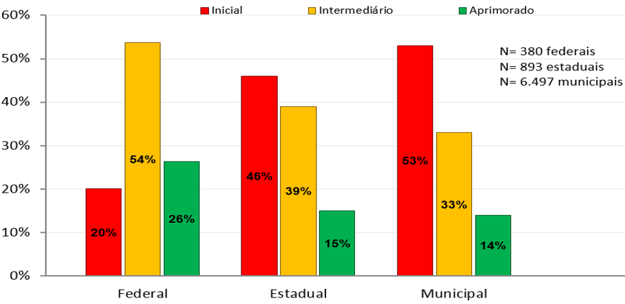

Public Governance Indicator - IGG
Notes:
This other graph shows that the situation is bad in the Federal Government, but worse in states and municipalities.
The horrible situation of governance in the states and municipalities explain, to a great extent, why so many resources are diverted from Brazilian education, for example.
Diversions affect even investments in public transportation and meals for children.
Drawing a parallel, criminals find ungoverned houses – with corrupt or unprepared leaders, open windows, no locks, no alarms, no security tools and act more easily to remove resources that could mitigate our inequalities.

Slide 11
Role of Center of Government
Strengthening Center of Government to:
Ensure the vision of a more strategic State
Policies are better conducted
Ensure coherence of the whole of government
Building a State that is more at the service of its people
Coordinate stakeholders involved in the public policies processes
Ensuring delivery capacity of quality services and appropriate public policies
Results:
Monitor and evaluate from an integrated government perspective
Increase in citizens’ trust in the capacity of the government
Promote communication and accountability
Notes:
Talk about the importance of strengthening center of government

Slide 12
Subproject KNI and Public Governance
9th WG/KNI Meeting – Armenia;
TCU proposes a Subproject on KNI and Public Governance;
1st stage of the Subproject: Research performed with INTOSAI SAIs.
Notes:
Say that the Minister participated in the 9th meeting of the WG/KNI, in Armenia (with Luiz Akutsu and Claudio Sarian).
The Minister himself proposed the subproject addressing KNI and Public Governance.
The first stage of the subproject was a research with INTOSAI member SAIs.
-

Slide 13

KNI and Public Governance Research
48 SAIs answered (8 of them are part of WG KNI):
EUROPE: Austria, Denmark, Finland, France, Greece, Netherlands, Italy, Luxemburg, Poland, Portugal, Czech Republic, European Union;
BRICS: South Africa, Brazil, India e Russia;
NORTH AMERICA: Canada, USA and Mexico;
SOUTH AMERICA: Argentina;
AFRICA: Ghana, Senegal, Tunisia, Uganda e Zimbabwe;
ASIA: Afghanistan, Bhutan, Kazakhstan, United Arab Emirates, Malaysia.
Notes:
- Research sent to all INTOSAI Supreme Audit Institutions (SAI).
48 SAIs responded
From 48, only 8 are part of the INTOSAI Working Group on KNI (WG KNI).
In total, the WG KNI has 22 member SAIs and 2 observer SAIs.
-

Slide 14
Use of KNI by Government
Notes:
32 SAIs (67 %) said they have a reference guide on the use of KNI by government.

Slide 15
Maturity in the use of KNI
Notes:
Of these 32 SAIs that said they have a reference guide:
26 (81%) measure indicators periodically
20 (62%) use indicators in government decision making 20 (62%) have defined the indicators
2 (6,2%) are defining the indicators
2 (6,2%) said indicators have not been definided

Slide 16
Work regarding the use of KNI
Notes:
22 SAIs (46%) have performed or wish to perform work related to the application of KNI by Government
21 SAIs (44%) have not and do not wish to perform work related to the application of KNI by Government
Of these 21, 12 did not perform this type of work due to other planning priorities

Slide 17
Existence of norm on public governance
Application:
Notes:
89% of SAIs (43) said their country has norms on public governance.
Application:
- 22 SAIs said the norms apply to intra-organizational activities
- 35 SAIs said the norms apply to public agencies
- 29 SAIs said the norms apply to public policies
- 36 SAIs said the norms apply to the Center of Government

Slide 18
SAI performs or plans on performing work on governance

Slide 19
Use of indexes by SAIs to measure maturity in governance

Slide 20
Existence of norms that address connections between governance and use of KNI

Slide 21
Examples of work of other SAIs
Several examples of work cited by SAIs of countries such as:
USA (evaluation of cross agency priority);
Austria;
France;
India.
And for the European Court of Auditors (“Did the Commission and Eurostat improve the process for producing reliable and credible European statistics?”).
Notes:
Inform that SAIs from several countries and fromthe European Court of Auditors cited examples of work caried out on KNI and on Governance before going on t the next slide with the proposal of the next steps of the subprojcet: identification of good practices.
- USA/GAO: evaluated the OMB developed "cross agency priority" (CAP) goals which serve as proxies for KNIs

Slide 22
Next steps: 2nd stage of the subproject
Identification of good practices
We propose that the Working Group identify work performed by INTOSAI SAIs that can be considered good practices that consolidate governance and KNI.
Notes:
Propose identification of good practices/work on KNI and public governance as the next step for the subproject.

Slide 23
Importance of SDGs
A seguir, mais duas apresentações do TCU:
SDG Audit
Na operational audit of SDGs in INTOSAI
Notes:
After the coffee break, TCU auditors will make two presentations that will address another importance aspect related to governance and KNI: the Sustainable Development Goals (SDGs):
“Auditing of Sustainable Development Goals”
“Performance Audit Approach in INTOSAI for the SDGs”

Slide 24
Thank you for your presence
Minister Augusto Nardes

