Slide 1
INTOSAI WORKING GROUP ON KEY NATIONAL INDICATORS
Knowledge base on KNI
Mr. Dmitry Zaytsev
Accounts Chamber of the Russian Federation
Brasilia, April 26, 2017

Slide 2
INTOSAI WORKING GROUP ON KEY NATIONAL INDICATORS
Knowledge base traffic

Slide 3
INTOSAI WORKING GROUP ON KEY NATIONAL INDICATORS
Top 10 visitors

Slide 4
INTOSAI WORKING GROUP ON KEY NATIONAL INDICATORS
Visitors of the Knowledge base
Russia
United Kingdom
Kyrgyzstan
Ukraine
Azerbaijan
United States
Italy
Kazakhstan
Brazil
Latvia
Armenia
Bulgaria
Moldova
Austria
Iraq
Pakistan
Mexico
United Arab Emirates
Australia
Slovakia
Zambia
China
Cyprus
Tajikistan
Germany
Totally 77 countries

Slide 5
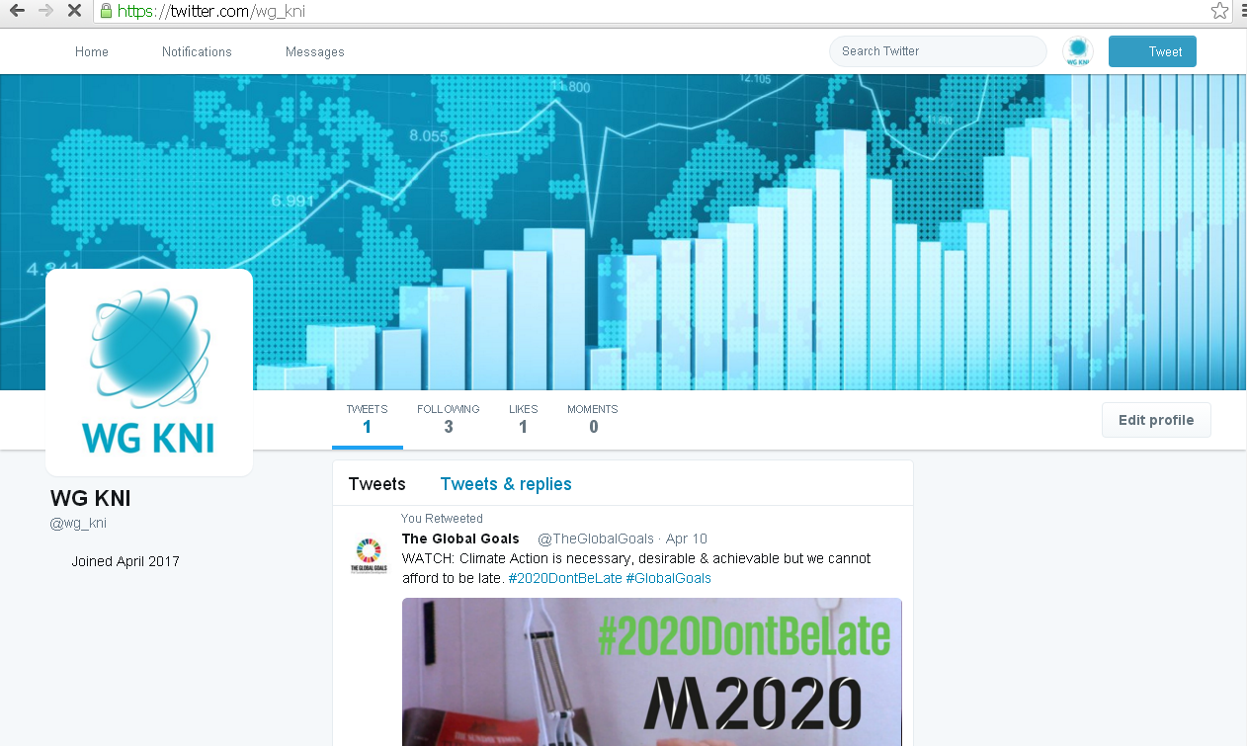
INTOSAI WORKING GROUP ON KEY NATIONAL INDICATORS
Working group on KNI on Twitter
Notes:
At the meeting in Armenia our Indonesian colleagues asked the Secretariat about the possibility to make the Knowledge base more interactive so that the member-countries could get the KB news without everyday checking the website.

Slide 6
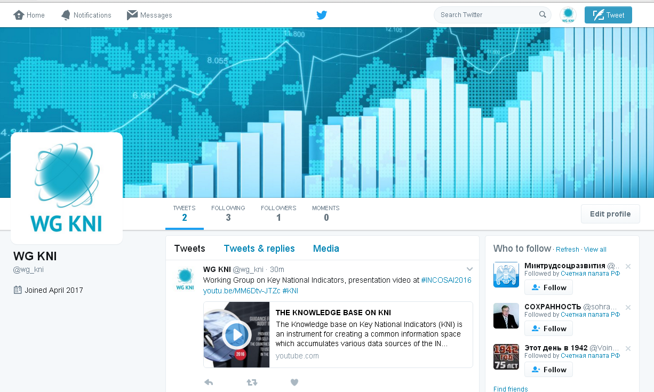
INTOSAI WORKING GROUP ON KEY NATIONAL INDICATORS
Twitter is a micro-blogging service micro-blogs up to 140 characters

Slide 7
INTOSAI WORKING GROUP ON KEY NATIONAL INDICATORS
To sign up for Twitter you will need an e-mail address or phone number

Slide 8
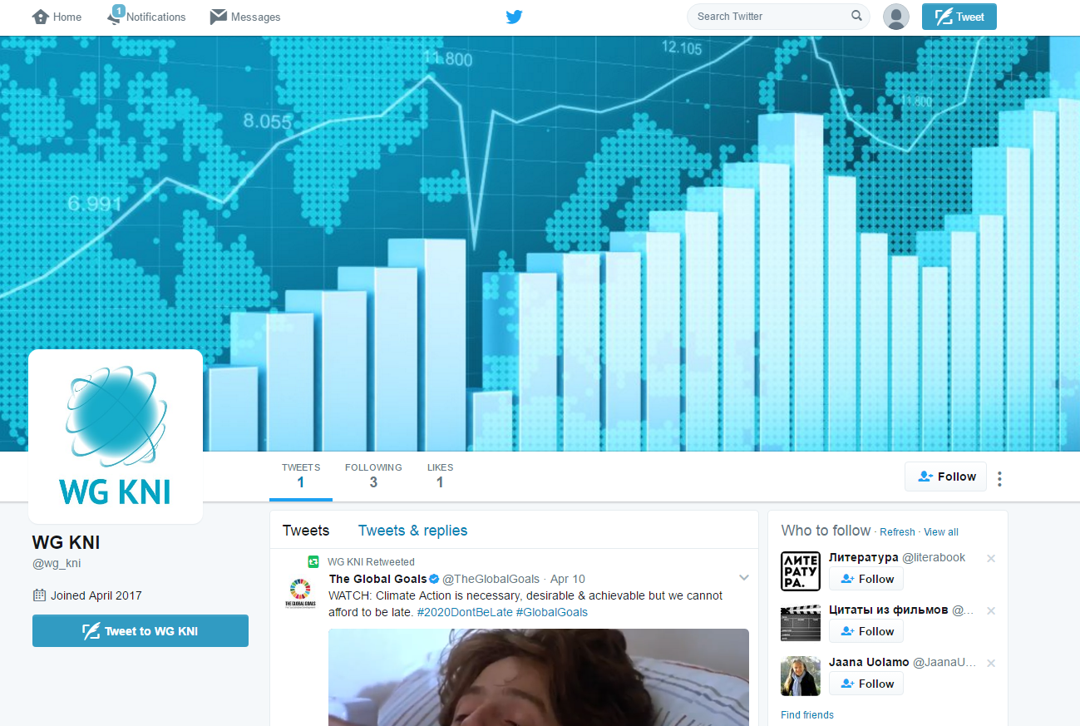
INTOSAI WORKING GROUP ON KEY NATIONAL INDICATORS
Using Twitter, you can see what other people are doing by following their tweets

Slide 9
INTOSAI WORKING GROUP ON KEY NATIONAL INDICATORS
The tweets are listed in chronological order on your Twitter homepage from all the people you follow

Slide 10
INTOSAI WORKING GROUP ON KEY NATIONAL INDICATORS
THANK YOU!
#KNI

